Slide 1


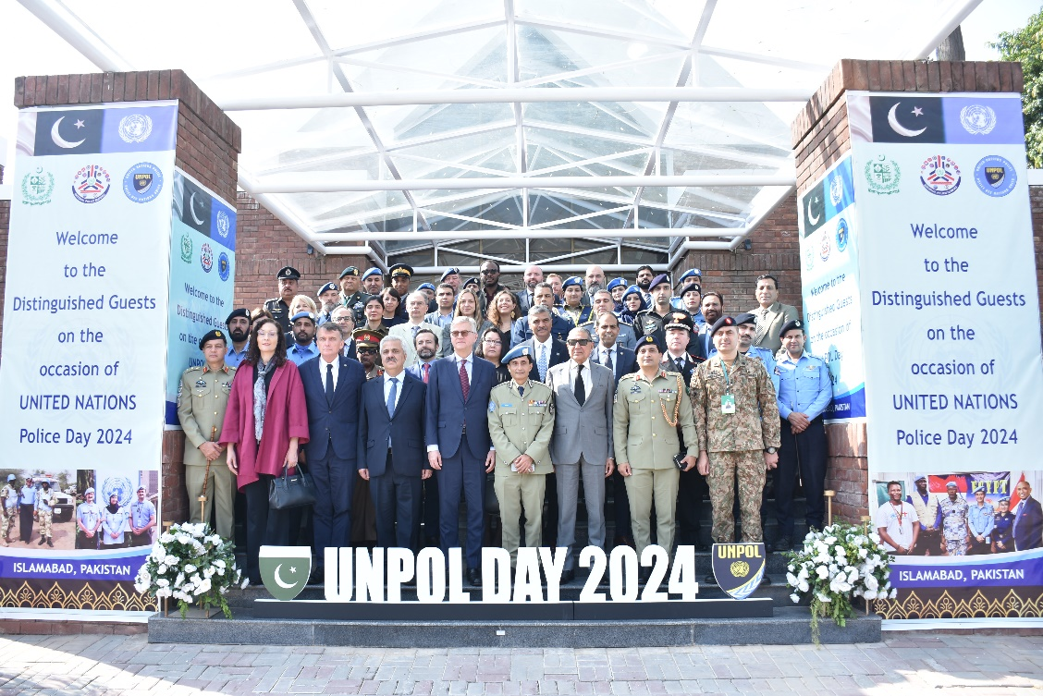
NATIONAL POLICE ACADEMY
United Nations Police Day 2024
NEWSLETTER
JUL-2024-DEC-2024
VOL 06
CONTENTS
UNPOL Day 1
40th MCMC 2
Class Sessions 3
26th ICC POP 4
Graduation 5
Physical Activities 6
Class Sessions 7
Country Study Tours 8
Visit to Police Organizations 9
Guest Nights 10
Mess Night 11
Cultural Night 12
Workshop 13
41st MCMC 14
Class Sessions 15
27th ICC Physical Tests 16
Capacity Building Courses 17
Workshop 18
51st CTP ACs of Pakistan Customs 19
Brief on NPA 20
United Nations Police Day honors the role of UN Police in promoting peace, security and the rule of law in conflict-affected areas. It recognizes service, sacrifice and commitment of Police in protecting civilians and supporting law enforcement agencies worldwide.
Pakistan hosted UN Police Day for the first time at the National Police Academy with global representation of police officers.
HIGHLIGHTS
26th ICC Graduation Page No.04
41st MCMC Ceremony Page No.13
51st CTP Assistant Collectors of Pakistan Customs Page No.17
1

Slide 2
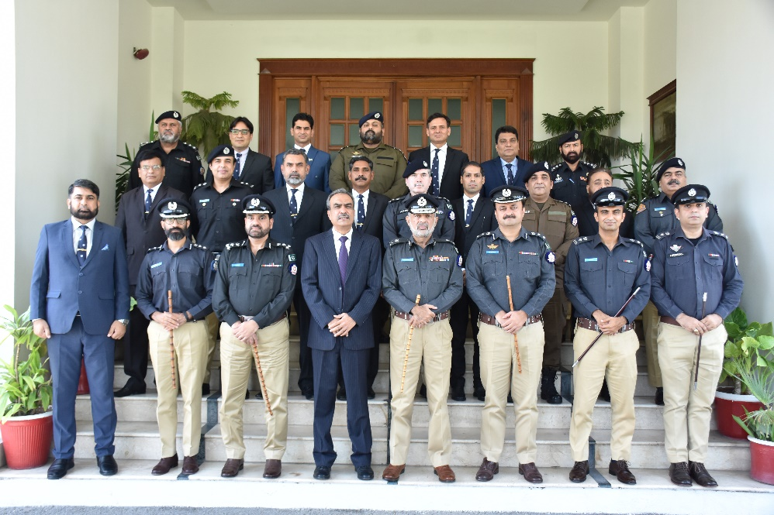
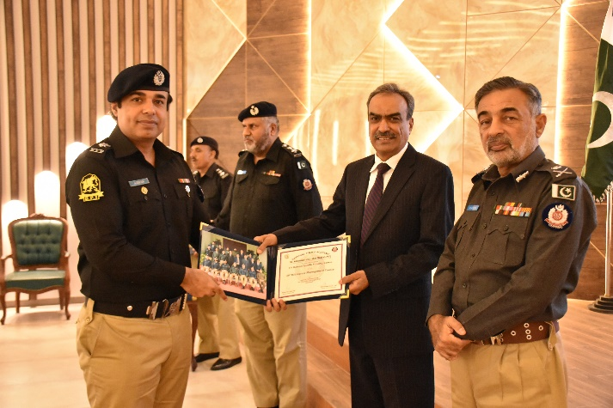
40th MCMC Graduation Ceremony
Domain-specific MCMC is promotional course for officers of police and Law Enforcement Agencies in BS-18. It focuses on organization-specific knowledge, skills, attitudes, encouraging mutual learning and experience-sharing. The curriculum blends professional, developmental, and research components to prepare participants for future leadership roles.
On 02nd August 2024, Graduation Ceremony of 11th Domain Specific/ 40th Mid-Career Management Course (MCMC) was held at the National Police Academy, Islamabad. The batch comprises 15 officers, 05 officers from PSP, 04 officers from FIA and 06 officers from NAB.
Group Photo with chief guest
PARTICIPANTS
Mr. Abdul Rauf Babar, PSP Rai Nasrullah, FIA
Mr. Hasam Bin Iqbal, PSP Mr. Asif Waheed, NAB
Syed Javed Iqbal Gharshin PSP Mr. Eric Paul, NAB
Mr. Asad Ullah Nasir, PSP Mr. Waqar Ul Hassan, NAB
Mr. M. Azhar Khan Mughal, PSP Mr. Ejaz Bashir, NAB
Mr. Sarfraz Ali, FIA Mr. M. Asif Munir, NAB
Mr M. Bilal Naeem, FIA Mr. Majid Ali Malik, NAB
Mr. M. Abid Hussain, FIA
Certificate distribution
2

Slide 3
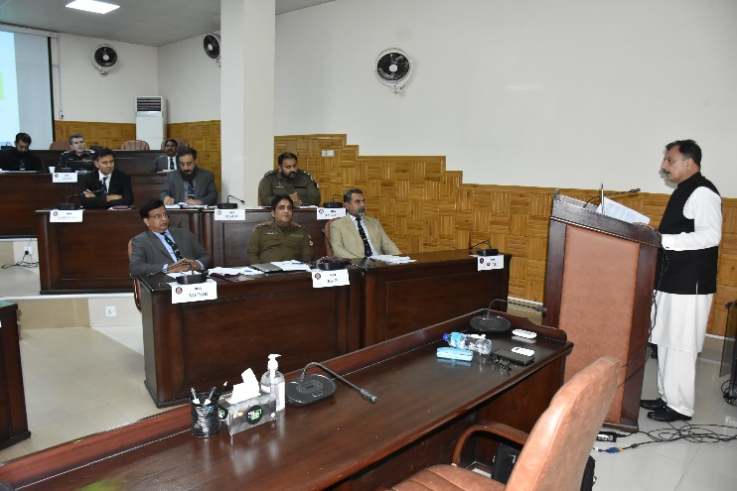
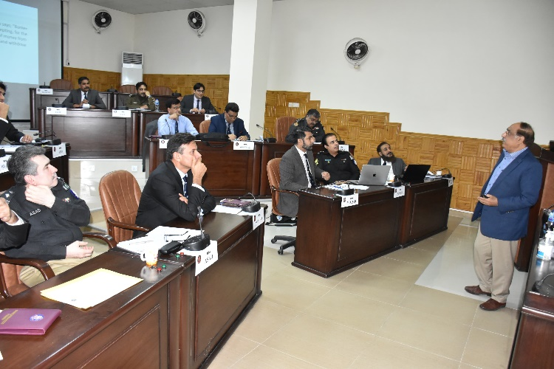
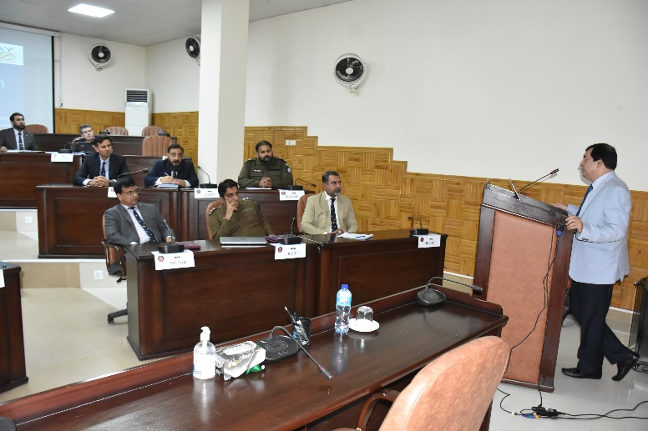
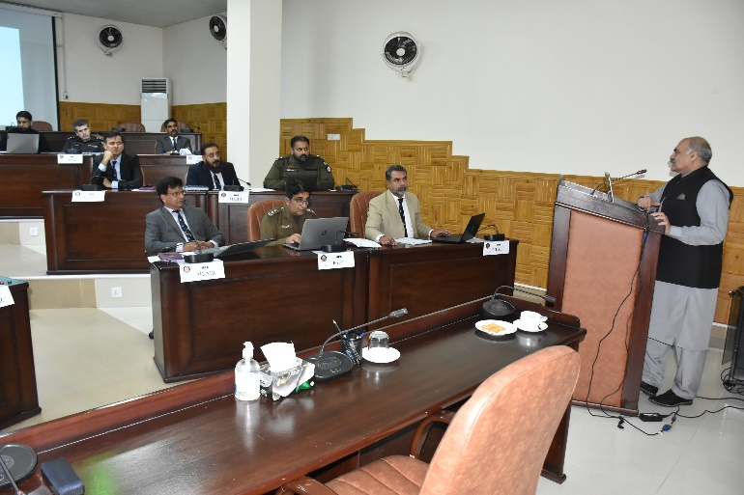
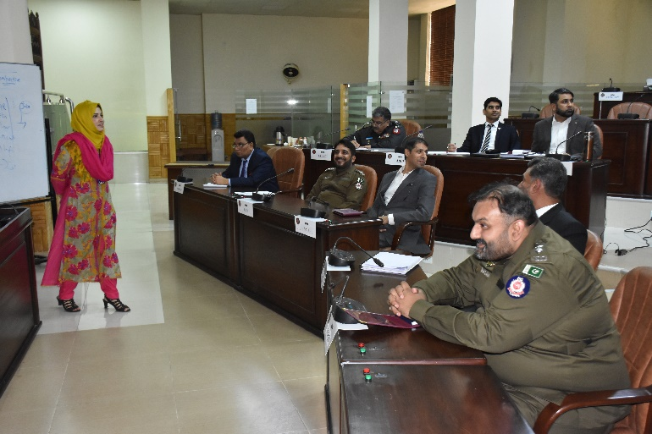
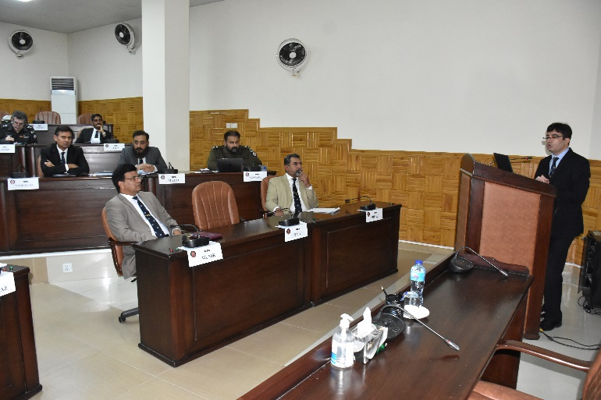
40th MCMC Class Sessions
Addl. IGP Muhammad Ali Babakhail, PSPPSP
IGP (R) Tariq Masood Yasin, PSP
Mr. Sohaib Ahmed Roomi, Advisor to Chairman NAB
Director Law, FIA Masoom Naseem
Associate Professor (NUST) Ume Laila
DIG Sikandar Hayat, PSP
3

Slide 4
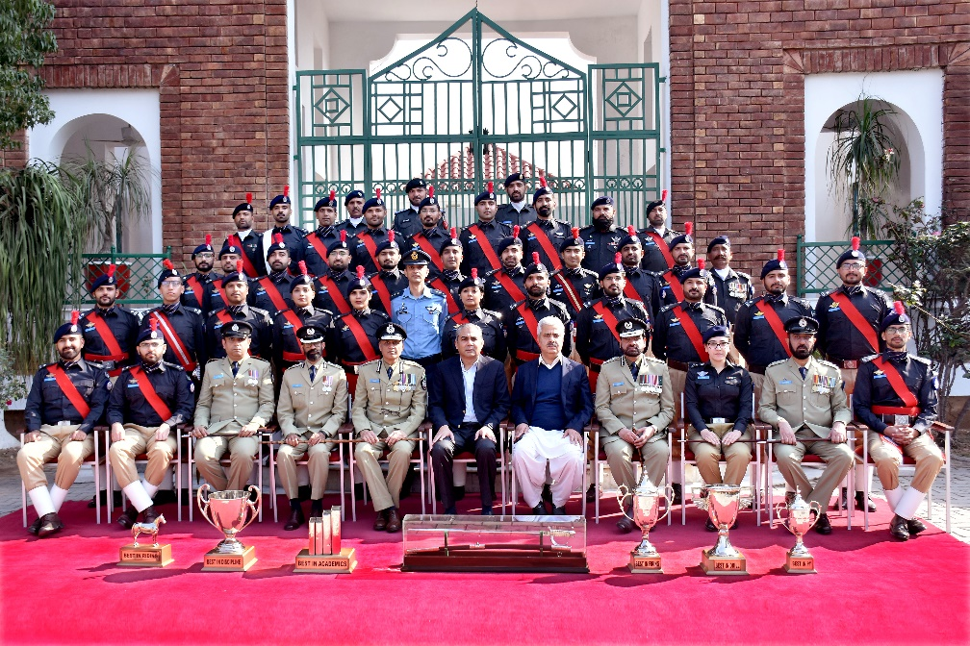
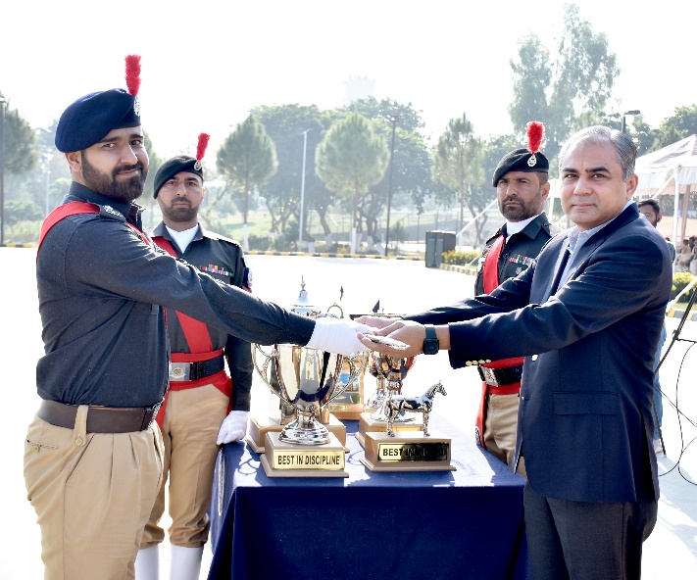
26th ICC Passing Out Parade
On 22nd November 2024, Passing Out Parade of ASsP of 26th ICC was held at the National Police Academy, Islamabad. State Minister for Interior and Narcotics Control Syed Mohsin Raza Naqvi was the guest of honour. The batch comprises 30 officers including 03 female officers. Two PAF officers undertook development phase of the ICC training. In his address, the chief guest said that nation is facing grave threat from non-state actors today. The innumerable sacrifice of public, law enforcement agencies and police have helped in stemming the tide of terrorism. The Chief Guest also affirmed to revamp training related activities of the National Police Academy. Later on, the Chief Guest reviewed the parade and awarded trophies to high achievers of the batch.
Group Photo with Chief Guest
Awards
All Round Best Sardar Usman Saleem
Best in Academics Sardar Usman Saleem
Best in Parade Capt. (R) M. Inzamam
Best in Firing Malik Bedar Bakht
Best in Physical Ms. Noor-ul-Ain Ali
Best in Discipline Mr. Muhammad Noman
Best in Riding Ms. Minahil Khawaja
Sardar Usman Saleem
All Round Best ASP
4

Slide 5
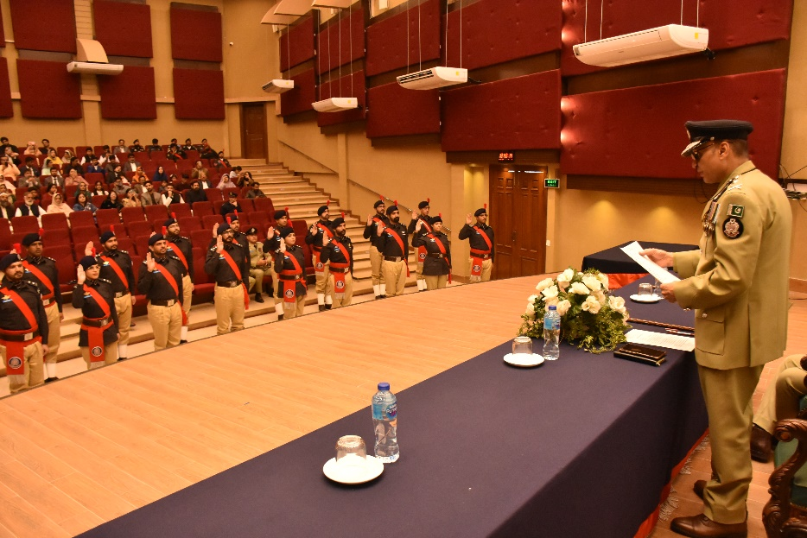
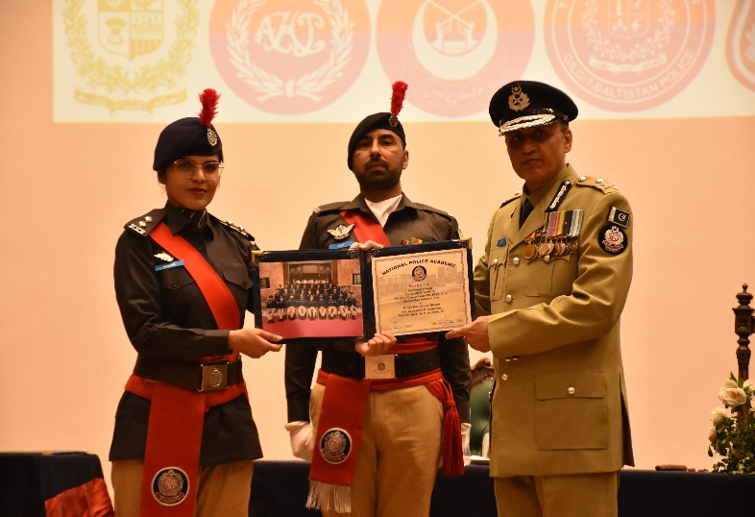
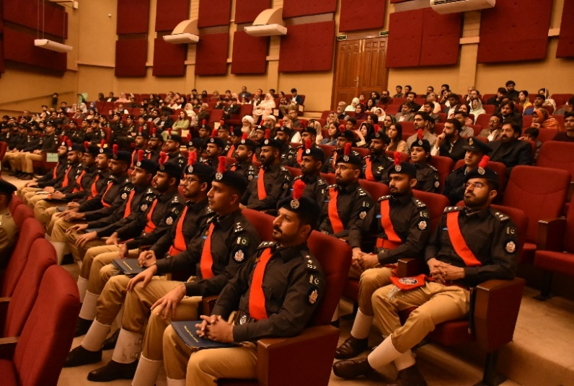
26th ICC Graduation
After Passing Out Parade and the award distribution ceremony, Commandant NPA Mr. Muhammad Idrees Ahmed presided over the oath taking, graduation and pinning of ranks ceremony of ASsP of 26th ICC. All senior officers of the Academy, parents, spouses and close family members of graduating officers attended the ceremony.
Oath taking ceremony of ASsP
Certificates Distribution
Certificate distribution
Graduating Officers and their families
5

Slide 6
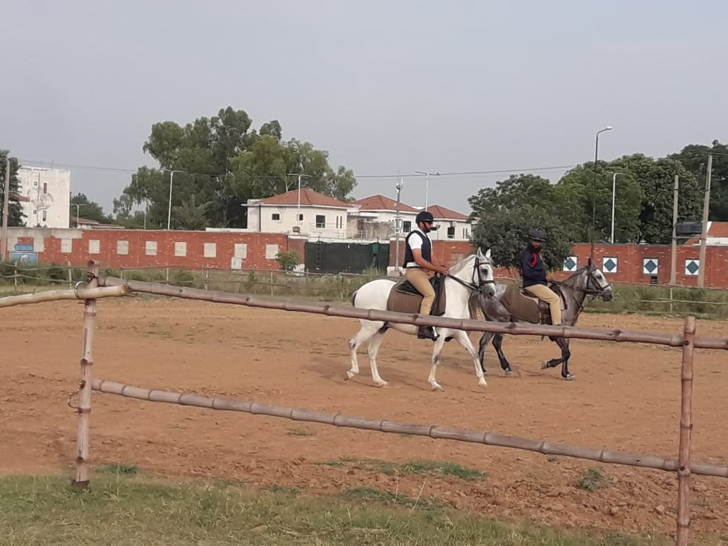
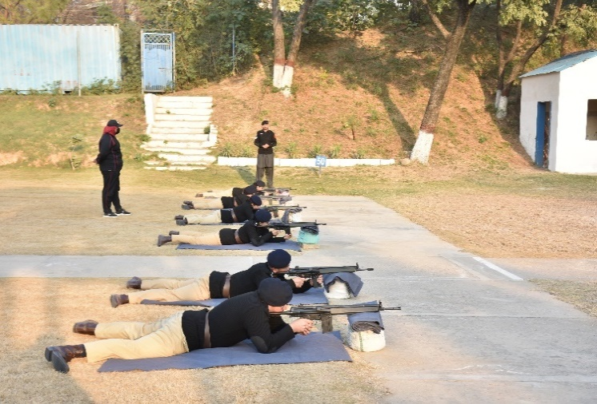
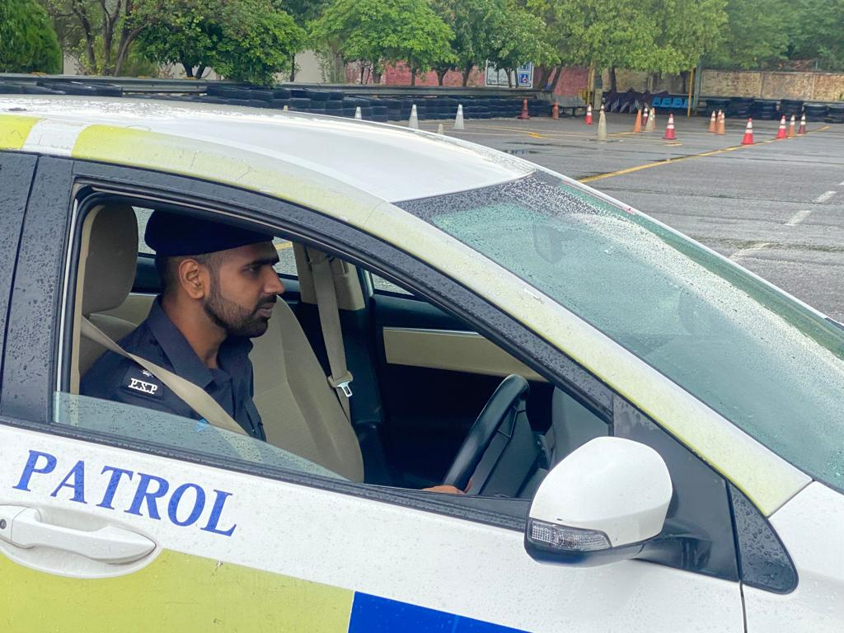
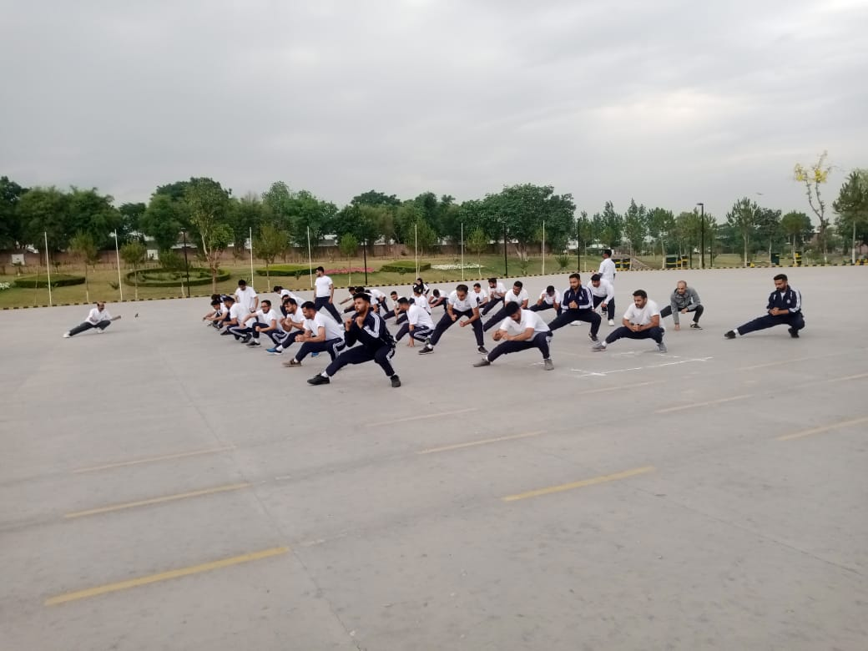
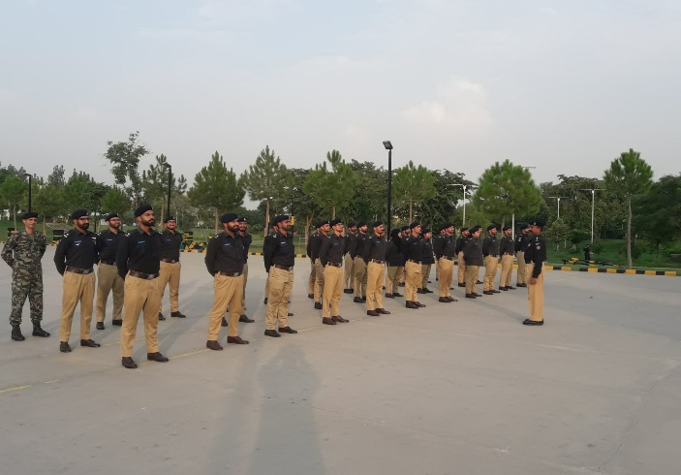
26th ICC Physical Activities
Physical fitness for police officers is the ability to perform essential tasks with vigour alertness and little or no fatigue with the rapid recovery after high levels of exertion, which enable police officers to maintain good judgement and make the best decisions. The ICC physical activities and skill development include riding, weapon handling, physical training (PT), drill and obstacles.
Riding Arena, NPA
Firing
Driving
PT
Parade
6

Slide 7
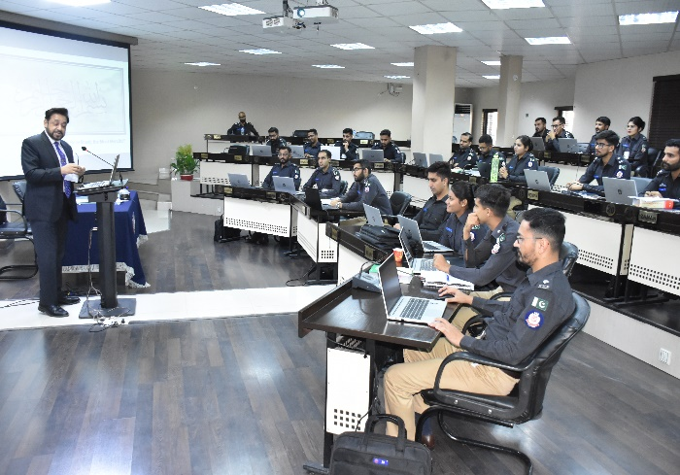
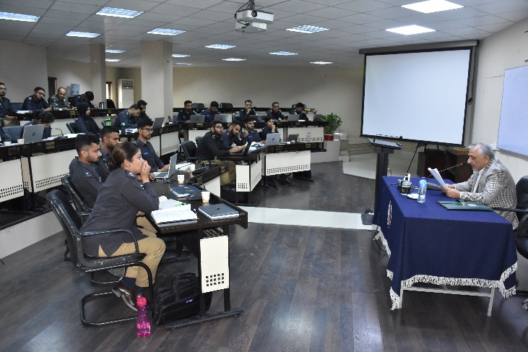
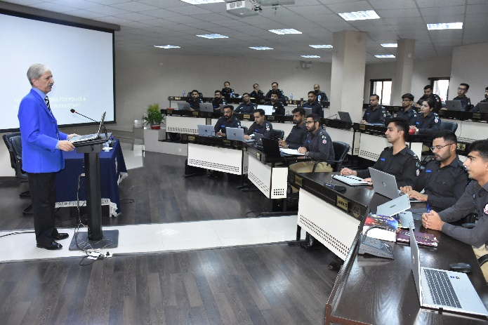
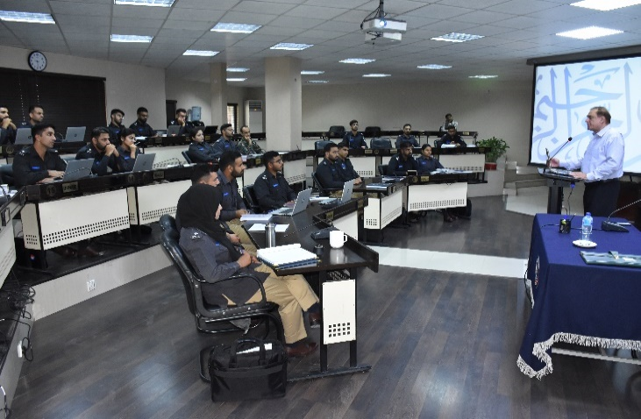
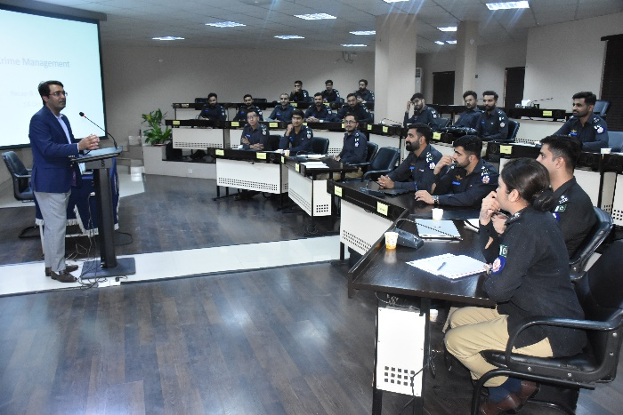
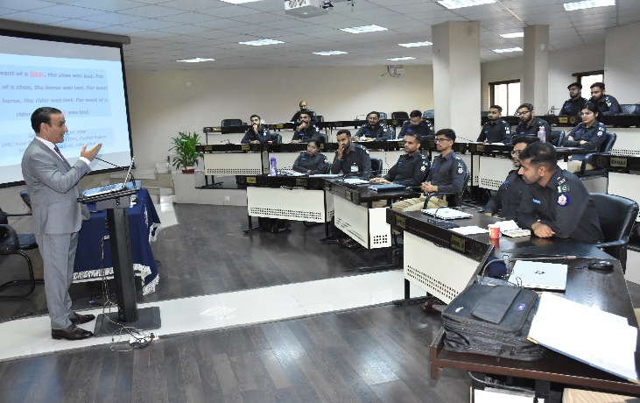
26th ICC Class Sessions
IGP (R) Syed Kaleem Iamam, PSP
Barrister Zafarullah Khan
Air Martial (R) Masood Akhtar
IGP (R) Tahir Alam Khan, PSP
DIG Umar Riaz, PSP
DIG Sajid Kiani, PSP
7

Slide 8
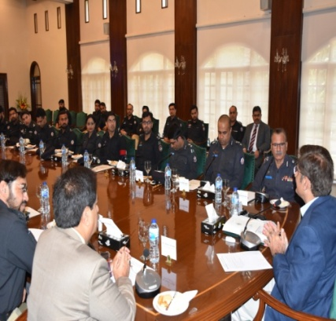
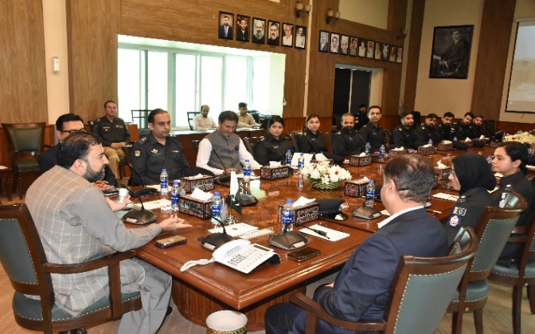
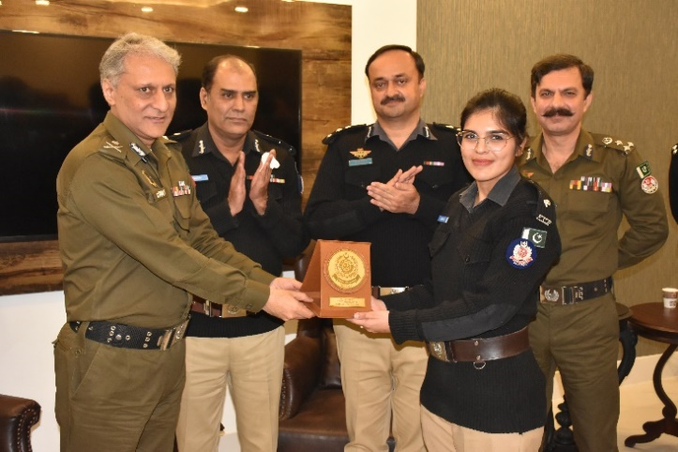
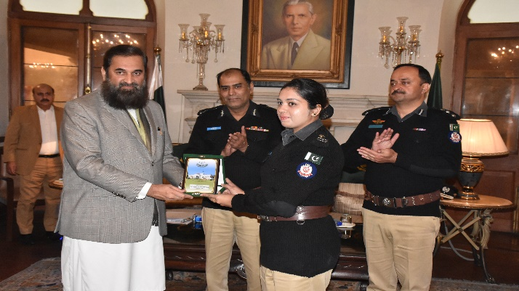
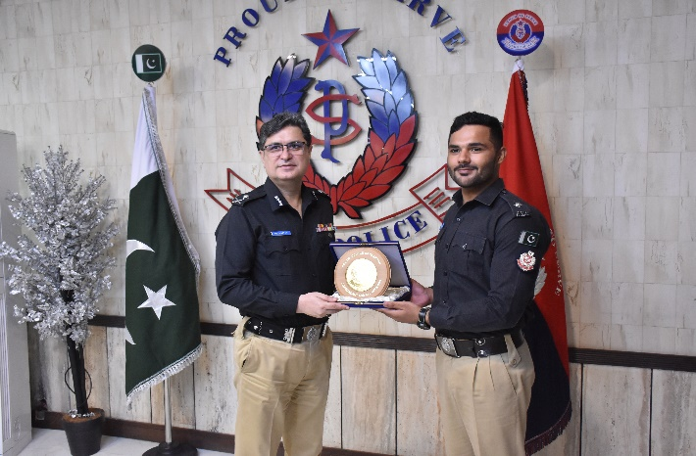
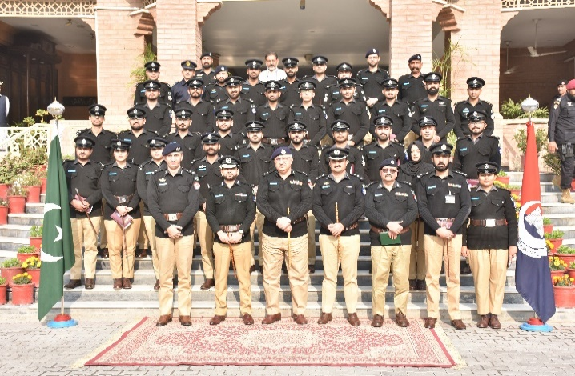
26th ICC Country Study Tours
Call on Chief Minister Sindh at CM office,
Karachi
Call on Chief Minister Balochistan
at CM Office, Quetta
ASP UT Minahil Khawaja presenting NPA shield to IGP Punjab
ASP UT Noor ul Ain receiving shield from Governor Punjab
ASP UT Awais Ilyas presenting NPA shield to IGP Sindh
Group Photo with IGP KP, CPO Office, Peshawar
8

Slide 9
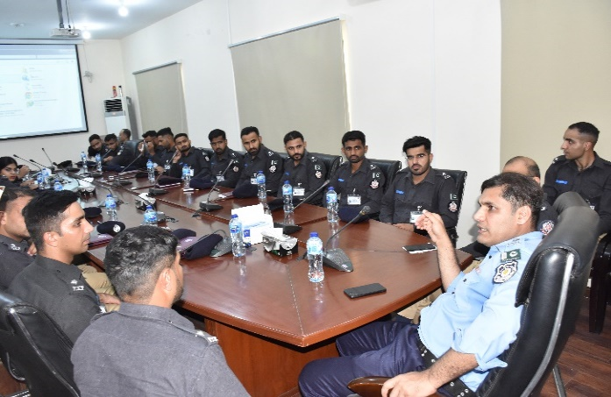
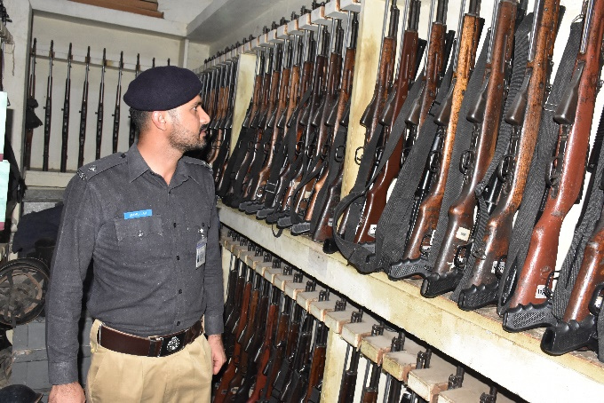
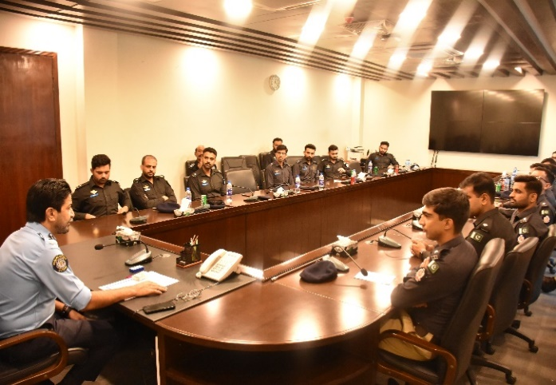
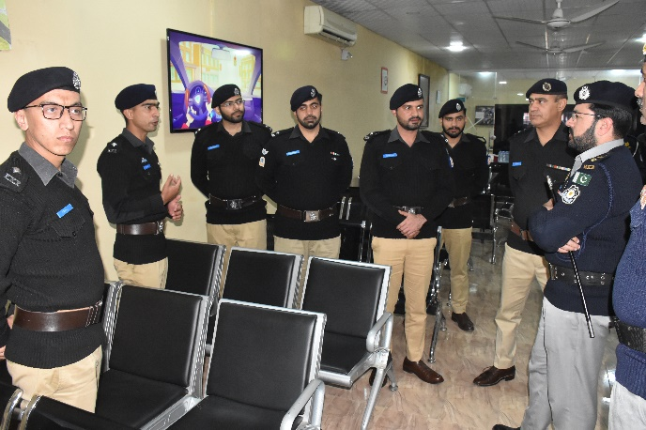
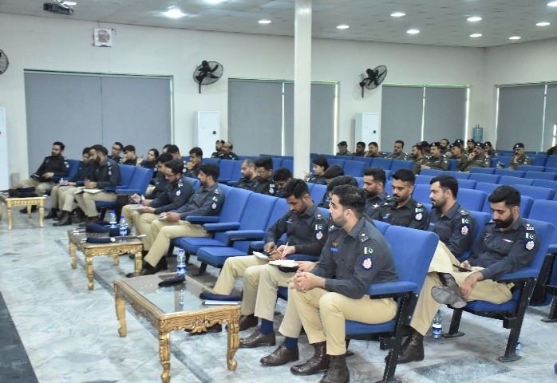
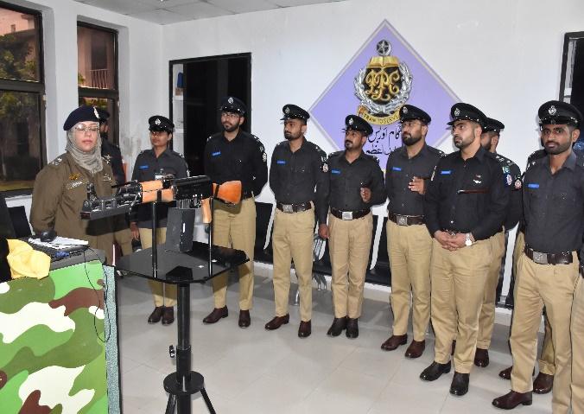
26th ICC Visit to Police Organizations
Visit to Islamabad Police Security Office
Weapon Inspection at ICTP HQ
Visit to Safe City Islamabad
Visit to ITP Office
Lecture at Rawalpindi Police Lines HQ
Visit to Police College Sihala
9

Slide 10
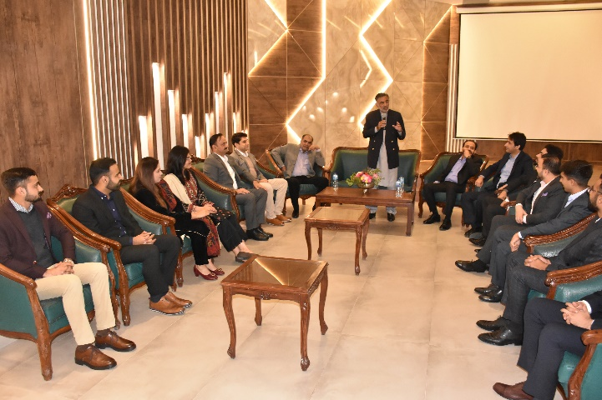
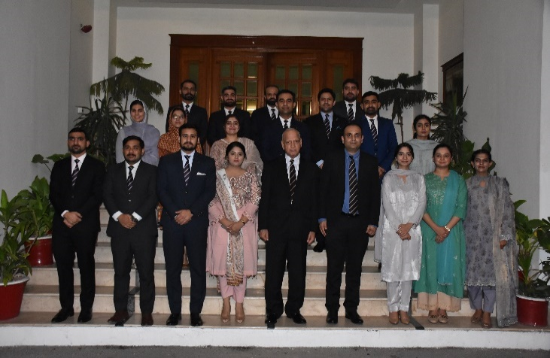
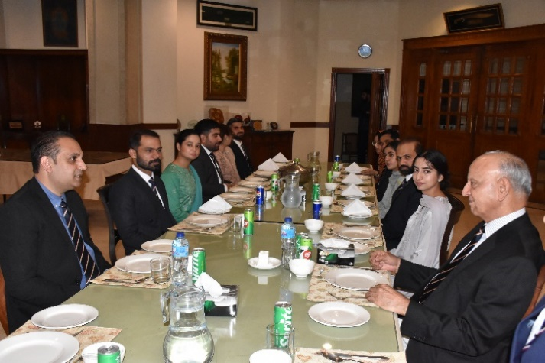
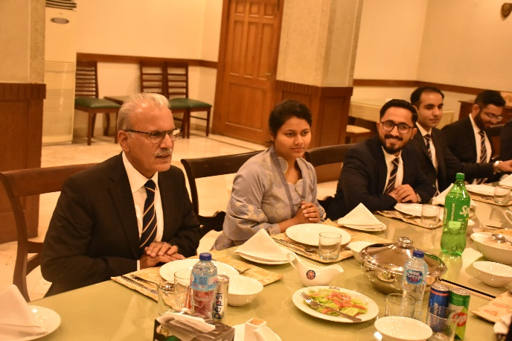
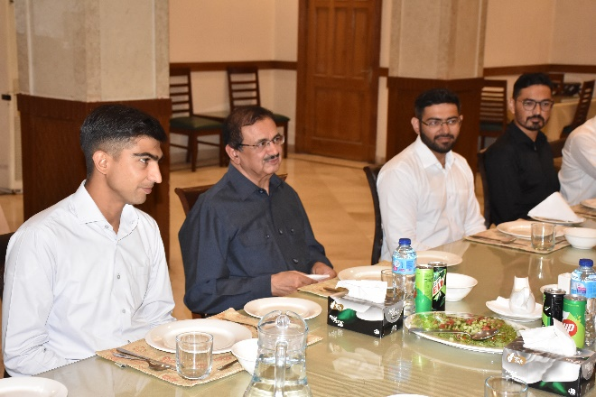
26th ICC Guest Nights
Guest Night is a formal event for the Assistant Superintendents of Police (UT) and senior officers of the Police Service of Pakistan, who grace the occasion as Chief Guests and share their professional experiences, insights and expertise gained during service in various police organizations
Words of advice by the Commandant, NPA
Group Photo with ASsP (UT)
IGP (R) Muhammad Shoaib Suddle with ASsP (UT)
IGP (R) Muhammad Tahir with ASsP (UT)
IGP (R) Zulfiqar Ahmed Cheema with ASsP (UT)
10

Slide 11
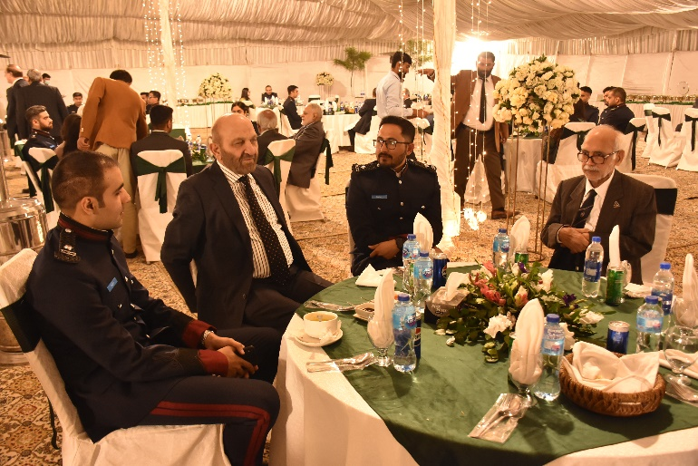
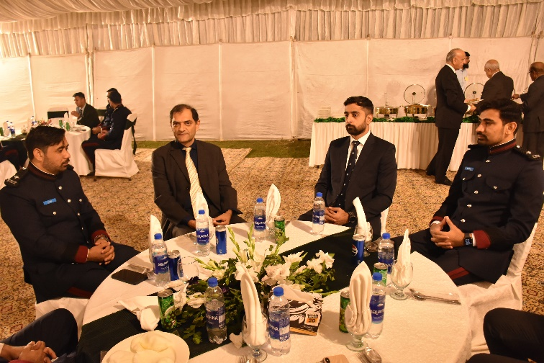
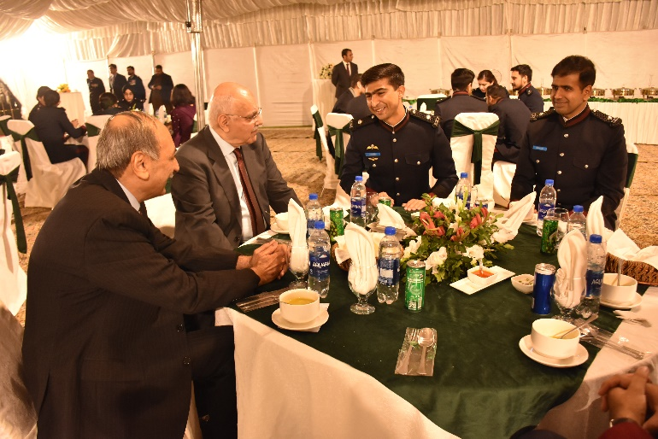
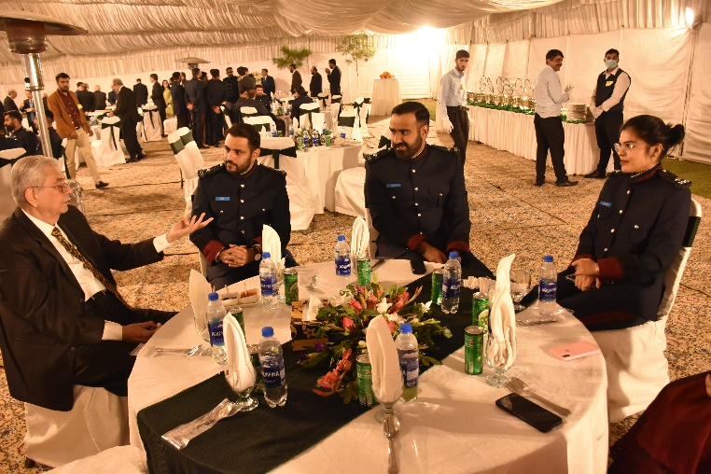
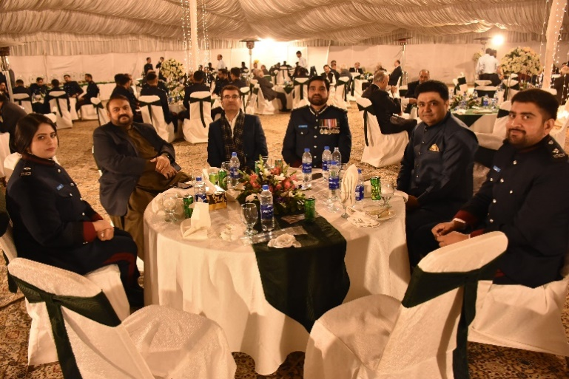
26th ICC Mess Night
Mess Night is a formal gathering for the Assistant Superintendents of Police (ASsP). The event is attended by the Commandant, National Police Academy and senior police officers both from outside and inside NPA. It gives an excellent chance to the under training officers to interact with senior police officers and other colleagues.
11

Slide 12
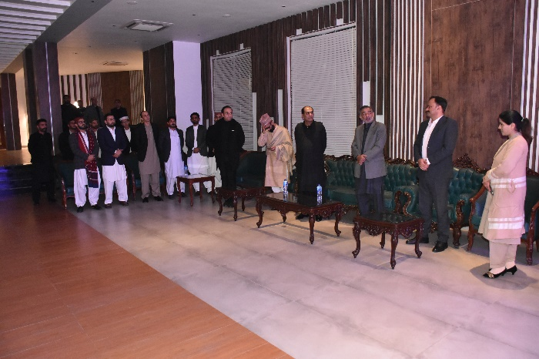
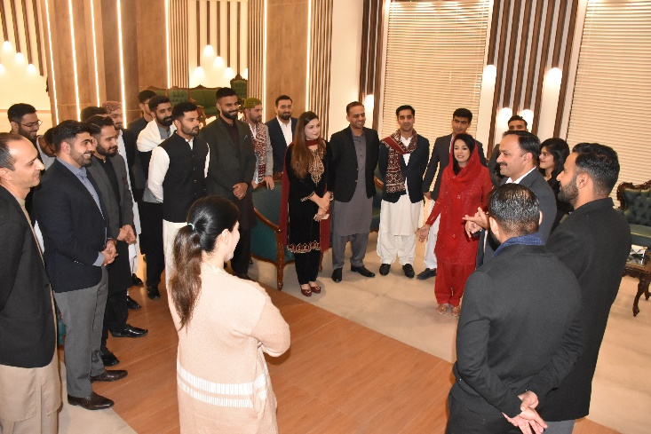
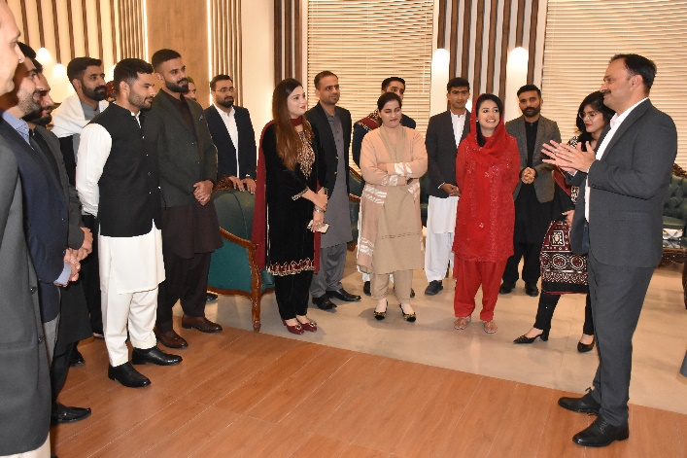


26th ICC Cultural Night
National Police Academy organized a vibrant Cultural Night for 26th ICC showcasing traditional songs and attire from their respective regions. The event highlighted the beauty of Pakistan’s diverse cultures and promoted mutual understanding and respect. The event was marked as evening of unity and celebration.
12

Slide 13






26th ICC Workshops on Counter Terrorism
Fixing goals for the Workshop
IGP (R) Tariq Pervaiz, PSP
IGP (R) Ihsan Ghani, PSP
Addl. IGP Shahzada Sultan, PSP
Mr. Umair Nazar, UNODC
DIG (R) Manzar Zaidi, PSP
13

Slide 14


41st MCMC Graduation Ceremony
Domain-specific MCMC is promotional course for officers of police and Law Enforcement Agencies in BS-18. It focuses on organization-specific knowledge, skills, attitudes, encouraging mutual learning and experience-sharing. The curriculum blends professional, developmental and research components to prepare participants for future professional roles.
On 20th December 2024, Graduation Ceremony of 12th Domain Specific/ 41st Mid-Career Management Course (MCMC) was held at the National Police Academy, Islamabad. The batch comprises 18 officers including 01 female officer, 12 offices of PSP and 06 officers from NAB.
Group Photo with Chief Guest
PARTICIPANTS
Mr. Malik Jameel, PSP Capt. (R) Sher Ali, PSP
Mr. Zubair Nazir Ahmed, PSP Capt. (R) Ghulam Murtaza, PSP
Muhammad Tariq Nawaz, PSP Capt. (R) Zuhaib Muhsin, PSP
Mr. Muhammad Imran, PSP Mr. Saadullah Khan, NAB
Ms. Suhai Aziz, PSP Mr. Qamar Shahzad, NAB
Syed Asad Muzaffar, PSP Mr. Shehzad Javed Khan, NAB
Mr. Ahmed Nawaz Shah, PSP Mr. Allah Rakha, NAB
Mr. Muhammad Sami Malik, PSP Mr. M. Fiaz Afzal, NAB
Capt. (R) Ali Bin Tariq, PSP Mr. Zaheer Ahmad, NAB
Certificate Distribution
14

Slide 15






41st MCMC Class Sessions
DIG Kamran Adil, PSP
IGP (R) Syed Kaleem Imam, PSP
DIG Sajid Kiani, PSP
DIG Mirvais Niaz, PSP
Journalist Talat Hussain
Director Audit (R) Arshad Baig
15

Slide 16





27th ICC Physical Tests
Physical tests of 27th ICC were conducted at the National Police Academy. Skills of the under training officers were evaluated in riding, firing, obstacle, physical training (PT) and parade. Physical tests were evaluated by the Board of Examiners after receiving performance of each ASP (UT).
Riding
Firing
Obstacle
PT
Parade
16

Slide 17



Capacity Building Courses
Course | Organization | Dates
Professional Policing Under International Standards of Human Rights and Humanitarian Law | ICRC | 18-20 Sep
Advanced incident Response Commanders Course (BHC) | BHC/ NACTA | 30 Sep -11 Oct
National Police Academy is emerging and growing institution that continues to build capacity of leadership through structured modules. Capacity Building Courses on variety of policing subjects are held officers of police and other Law Enforcement Agencies including Police, Military Intelligence, Inter-Services-Intelligence, NAB, FIA, PAF, Rangers, IB, FC, Frontier Corps, NPB, NACTA, State Bank of Pakistan , FBR, ASF, CAA and Prisons.
Trained 60 senior officers in July 2024 –December 2024 through capacity building programs. These courses were attended by participants 30 Law Enforcement Agencies of Pakistan.
Group Photo
Group Photo
17

Slide 18


Workshops
Course | Organization | Dates
Gender Sensitive Community Policing | Accountability Lab | 2-4 Sep
Improving Financial Investigation Techniques and Citizen Engagement for Enhanced Accountability and Citizens Trust in State Institutions | Accountability Lab | 23-25 Sep
Gender Sensitization | HR Ministry | 25 September
National Police Academy is a vibrant institution that continues to build capacity of police and officers Law Enforcement Agencies through designing and delivering training Workshops are held to train senior law enforcement officers from Police, Military Intelligence, Inter-Services-Intelligence, National Accountability Bureau, Federal Investigation Agency, Pakistan Air Force, Rangers, Intelligence Bureau, Frontier Constabulary, Frontier Corps, National Police Bureau, NACTA, State Bank of Pakistan , FBR, ASF, CAA and Prisons.
Trained 83 officers in July 2024–December 2024 through workshops programs. The courses are attended by 30 Law Enforcement Agencies of Pakistan annually.
Group Photo
Group Photo
18

Slide 19




51st CTP Assistant Collectors (UT) of Pakistan Customs
Class Sessions
National Police Academy has designed a specialized training course for the 51st CTP Assistant Collectors of the Pakistan Customs. Duration of course was for one month in which the officers were educated in PT, Parade, uniform ethics, weapon handling, discipline & etiquette etc.
On 22nd November 2024, Graduation Ceremony of 3rd Specialized Training Course for 51st CTP Assistant Collectors of the Pakistan Customs was held at the National Police Academy, Islamabad. The batch comprised of 17 officers, including 06 female officers.
19

Slide 20
NATIONAL POLICE ACADEMY
NEWSLETTER
JUL-2024-DEC-2024
VOL 06
National Police Academy
Commandant
Mr Muhammad Idrees Ahmed, IGP
Deputy Commandant
Mr Sarfraz Ahmed Falki, DIG
DIG/Director
Central Planning & Training Unit
Mr. Haider Sultan
Course Commander
Mr. Fazl-i-Hamid, SSP
Director
Senior Command Course
Ms. Shazia Sarwar, SSP
Deputy Director Administration
Mr. Muhammad Farooq
Vision
To be a leading police training institute and a role model for all training institutes at national level imparting high quality training to in-service as well as newly recruited mid-level police managers. To uphold standards of performance, best practices reflecting values of a good public service organization and to be a center of excellence for all police training institutions.
Mission
Endowing police officers with ideals of justice, integrity and professional excellence through transformative training.
Content, design & composition
Mr. Fazl-i-Hamid, PSP, SSP
Course Commander
Syed Mazhar Hussain Kazmi, DSP
Assistant Director (CD)
THE BOARD OF GOVERNORS OF THE NATIONAL POLICE ACADEMY, ISLAMABAD
National Police Academy Islamabad is administered by an autonomous Board of Governors appointed by the government through Ministry of Interior and Narcotics Control duly registered under the Societies Registration Act, 1860 on 19th February 1979
NATIONAL POLICE ACADEMY, ISLAMABAD
SECTOR H-11, A K BROHI ROAD
www.npa.gov.pk
Telephone 00 92 (0) 51 9257419-21
Facsimile 00 92 (0) 51 9257414
20

