Slide 1


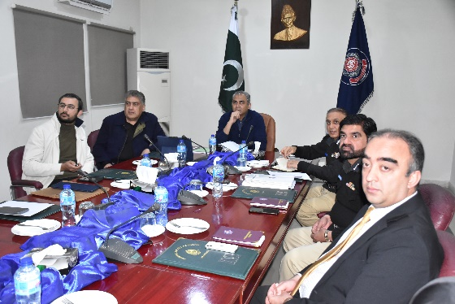
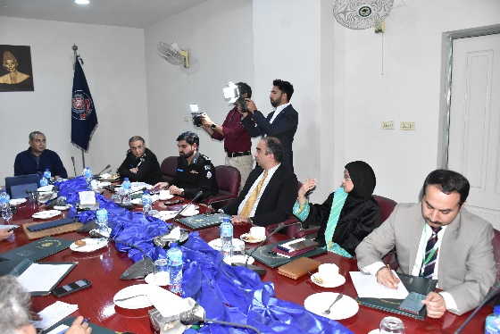
NATIONAL POLICE ACADEMY
Visit of Interior Minister Syed Mohsin Raza Naqvi
NEWSLETTER
JAN-2025-JUNE-2025
VOL 07
On 10th February 2025, Interior Minister Syed Mohsin Raza Naqvi visited the National Police Academy to review and initiate the renovation of classrooms and Hostel No. 4, incorporating a modern design to better facilitate the training of upcoming officers. During the visit, he also announced the allocation of 25 acres of land for the development of a Stable and Riding Area, Parade Ground, 500-meter Firing Range, Jogging Track, NPU building, and an Elite Training Setup.
The proposed infrastructure includes:
Trainee Tower: Ground plus 9 stories
Faculty Tower: Ground plus 5 stories
Tactical Training Block: Ground plus 2 stories, comprising an indoor firing range, firing simulator, two classrooms, a faculty room, common room, crime scene area, investigation and interrogation room, unarmed combat syndicate room, mock trial/courtroom, press conference area, and a multipurpose sports area.
CONTENTS
Interior Minister Visit 1
BOGs Meeting 2-3
NPTAC 4
NPTMB 5
42nd MCMC 6
Lecture 7
27th ICC 8
Physical Activities 9
Lecture 10
Study Tours 11
Visit to Police Organization 12
Guest Night 13
43rd MCMC 14
Lecture 15
Culture Night 16
2nd STC DSsP UT, Sindh 17 Guest Night 18
Physical Activities 19
Workshops 20
Police Martyrs’ Memorial Day 21
Last Page 22
HIGHLIGHTS
BOGs Meeting Page No.03
27th ICC Page No.08
2nd STC DSsP (UT), Sindh Page No.17
1

Slide 2
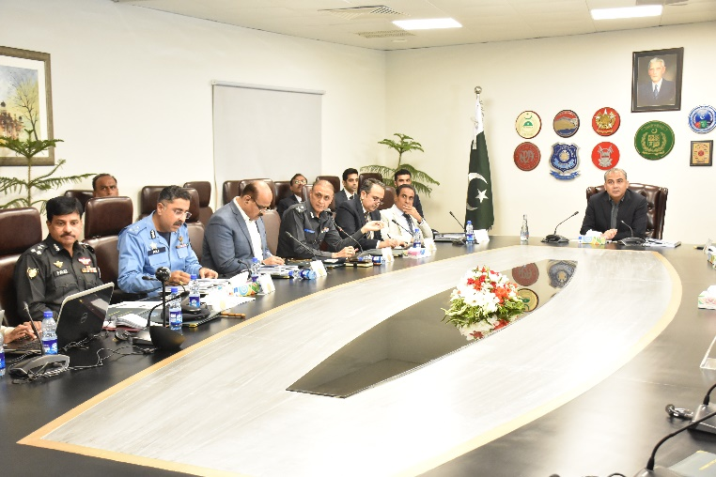
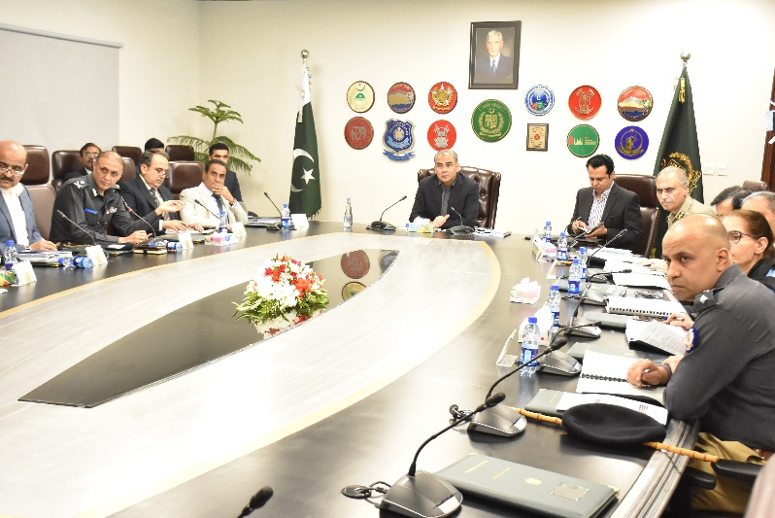
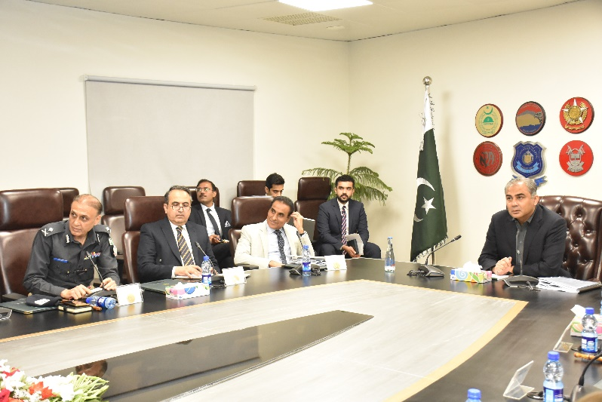
BOGs Meeting
16th Meeting of the Board of Governors (BOGs) of the National Police Academy was held at the Ministry of Interior’s Committee Room (1st Floor), Convention Centre, Islamabad on 29th April, 2025 under the Chairmanship of the Federal Minister for Interior/Chairman, BOGs. The Commandant, NPA, while warmly welcomed all participants and briefly apprised on the mandate & functions of BOGs, Thereafter the Deputy Commandant, NPA presented agenda of the 16th Meeting of BOGs.
Imperative decisions were made during the meeting to recommend,
Confirmation of Minutes of 15th BOGs meeting
Approval of presentation of Accounts of NPA
Approval of Composition of the Board of Governors (BOGs) and Executive Committee of BOGs (EC of BOGs)
Approval of Revision of Master Plan of NPA and Allotment of Additional Land
Approval of Acceptance of Grants-in-Aid from NPF, Provincial Governments ETC, in line with MOA
Approval of Validation of the decisions made by EC BOGs held on 13.02.2025
Approval of Placing Funds with CDA as deposit work against the Development work out of the Academy Fund
Approval of Enhancement of ICC Training Charges
Approval of purchase of vehicles from the Academy Fund
Contd…..
2

Slide 3
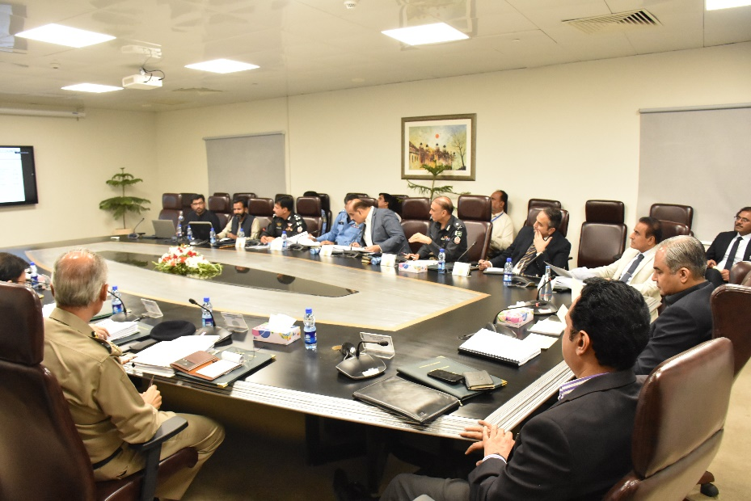
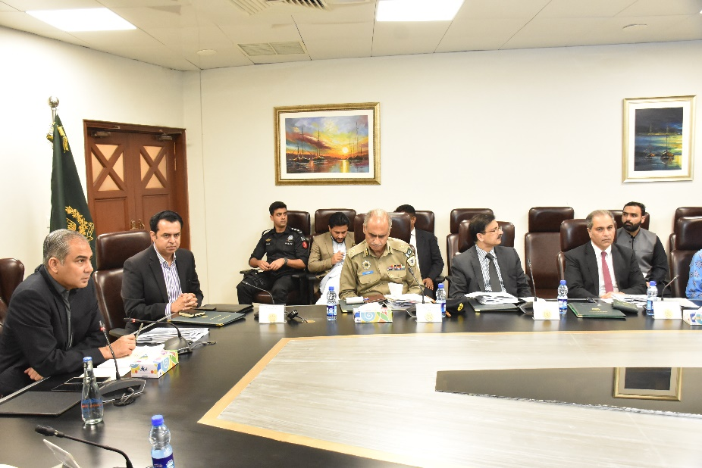
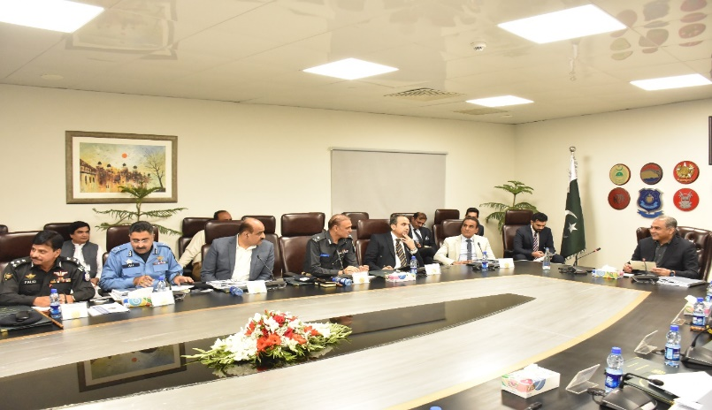
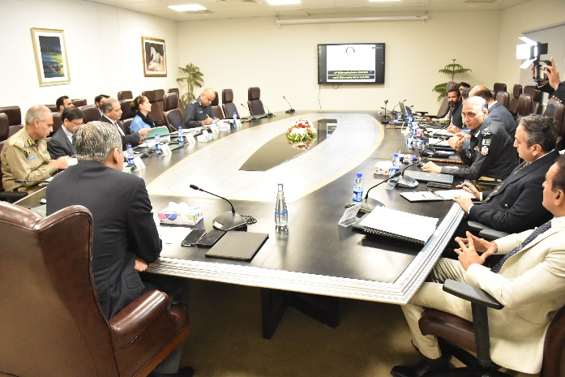
BOGs Meeting
Approval of Module on Cyber Crime & Employing the use of AI and IT in Policing & Award of Degree to ASsP on completion of ICC.
Approval of award of Degree to ASsP on completion of ICC
All agenda points were unanimously approved for recommendation to the Chairman and members of the Board of Governors. The NPA's dedicated efforts to enhance the organization in light of upcoming challenges for the Academy and trainee officers were appreciated.
3

Slide 4
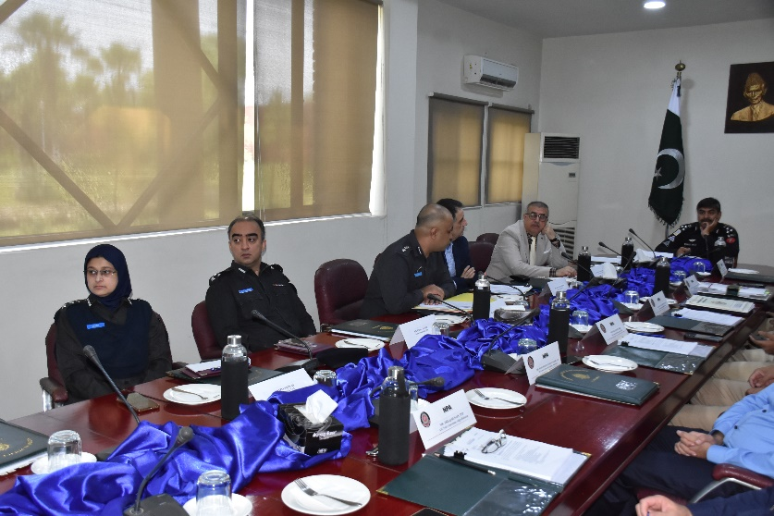
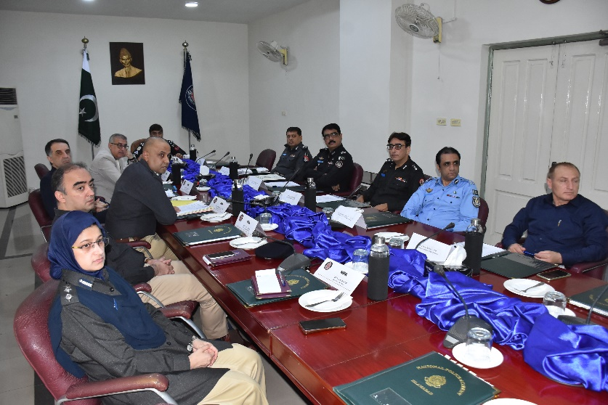
NPTAC Meeting
20th National Police Training Advisory Committee meeting was held on 26th May, 2025. Director CPTU, NPA, while welcomed the participants of meeting at the National Police Academy requested the Deputy Commandant, FC, Islamabad to preside over meeting being senior in house. After brief introduction on mandate & functions of NPTAC, agenda of the meeting was presented by the Director CPTU.
Imperative decisions were made during the meeting to recommend,
Confirmation of Minutes of 19th NPTAC meeting
Approval of Review FPOE Syllabus for 28th ICC
Approval of Enhancement of ICC to 79 weeks for 28th ICC
Approval of course Specific Document (4th Edition 2025) for 28th ICC
Approval of Evaluation, Discipline & Leave Policy (4th Edition 2025) for 28th ICC,
Approval of training of Female officers in case of pregnancy included in Evaluation, Discipline & Leave Policy
Approval of training calendar for 28th ICC
Approval of Introduction of Unarmed Combat Course for 28th ICC
Approval of Provision of Manpower to National Police Academy
Approval of Module on Cyber Crime & Employing the use of AI and IT in Policing & Award of Degree to ASsP on completion of ICC
All the agenda points were unanimously approved for recommendation to the training management board. The meticulous efforts of NPA to upgrade the training of young officers was duly lauded by all participants and it was appreciated by all that the training is constantly being steered in the direction of modern policing needs and contemporary best practice
4

Slide 5
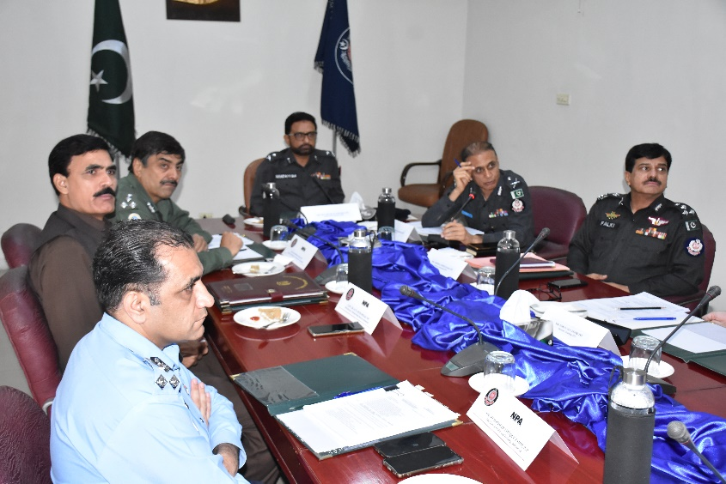
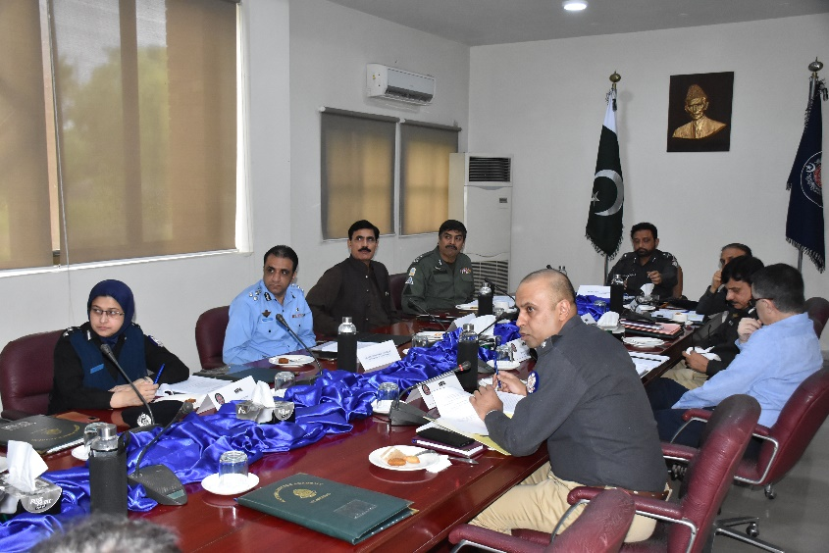
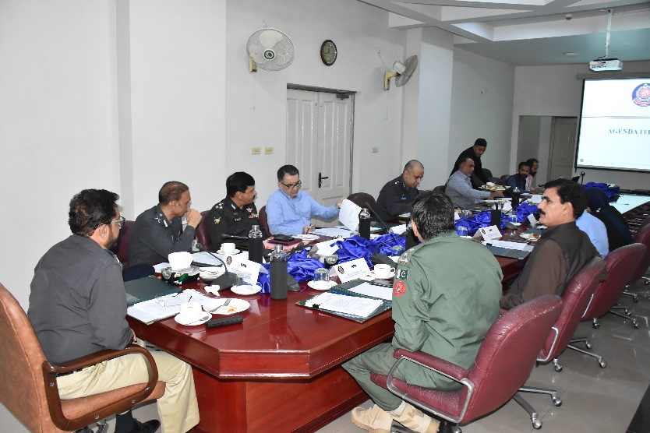
NPTMB Meeting
The 18th meeting of the National Police Training Management Board (NPTMB) was held at Committee Room of the National Police Academy on June 25, 2025 at 1130 hours under chairmanship of the Inspector General of Police, Pakistan Railways, Lahore. The agendas were discussed are as under:
Confirmation of Minutes of 17th NPTMB
Enhancement of ICC to 79 weeks
Course Specification Document (4th Edition 2025)
Evaluation, Discipline & Leave Policy (3rd Edition 2025)
Training of female officers in case of pregnancy included in Evaluation, Discipline & Leave Policy
Training Calendar for 28th ICC/52nd STP & Review of FPOE Syllabus
Introduction of Unarmed Combat Course
All the agenda points were unanimously approved for recommendation to the training management board.
The Chair appreciated efforts of the National Police Academy in bringing about innovations and improvements in the training related activities and also the efforts of the existing management of NPA were applauded by the Chair as well as the Board.
5

Slide 6
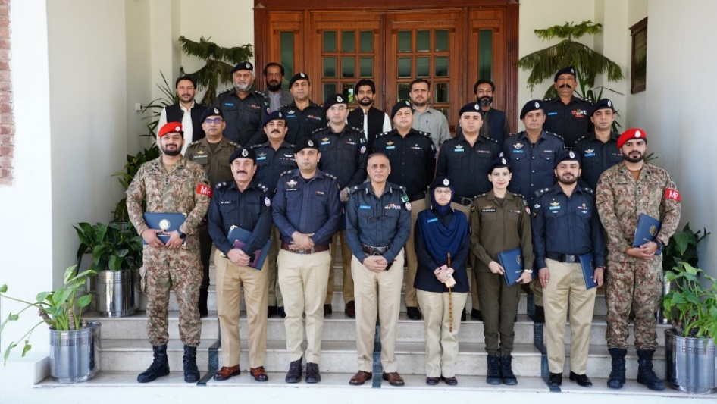
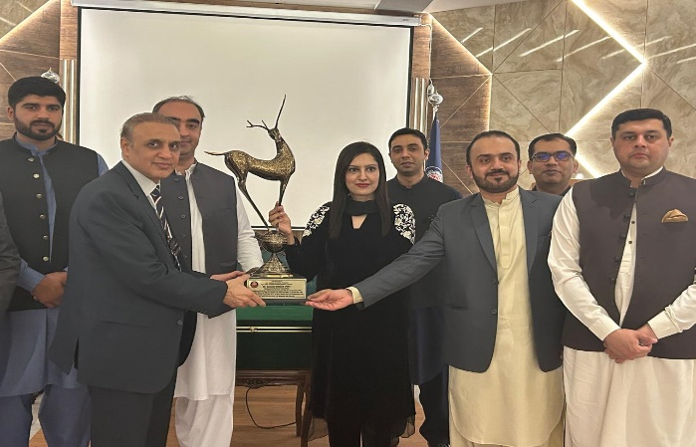
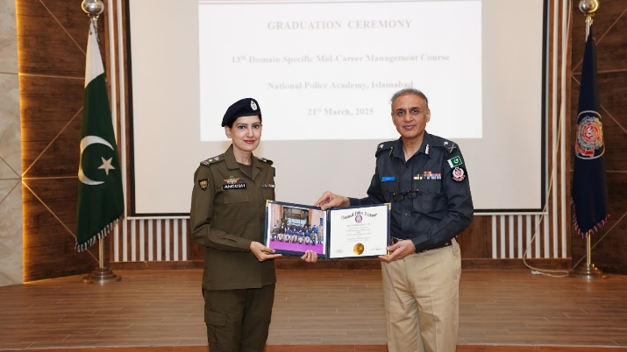
42nd MCMC Graduation Ceremony
The MCMC domain-specific course is designed for officers from Police, FIA, and NAB to enhance their professional competence and personal abilities. It focuses on organization-specific knowledge, skills, and attitudes, encouraging mutual learning and experience-sharing. The curriculum blends professional, developmental, and research components to prepare participants for future leadership roles.
On 21st March, 2025, Graduation Ceremony of 13th Domain Specific Specialized Training Course of 42nd Mid-Career Management Course (MCMC) was held at the National Police Academy, Islamabad. The batch comprises 12 officers including one female, 10 officers from PSP and 02 officers from Pak Army.
Group Photo of 42nd MCMC
Distribution of Certificates
42nd MCMC presenting souvenir to the Commandant, NPA
Mr. Muhammad Omer, PSP Capt. (R) Najmul Hassain, PSP
Mr. Shahzada Umar Abbas, PSP Flt. Lt. (R) Atta ur Rehman, PSP
Mr. Muhammad Kaleem, PSP Lt. (R) Fahad Khan, PSP
Mr. Farooq Ahmed, PSP Mr. Muhammad Ayaz, PSP
Capt. (R) Dost Muhammad, PSP Capt. Majeeb Ullah, Pak Army
Dr. Anoosh Masood Ch. PSP Capt. Muhammad Talha, Pak Army
Dr. Anoosh Masood Ch., PSP of 42nd MCMC
6

Slide 7
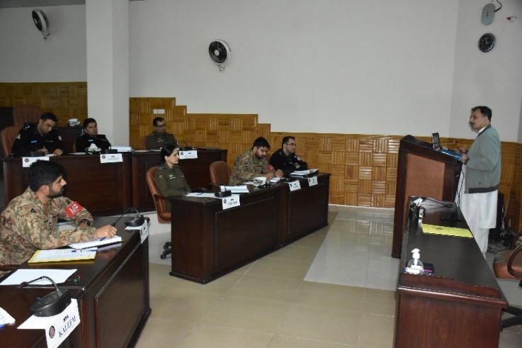
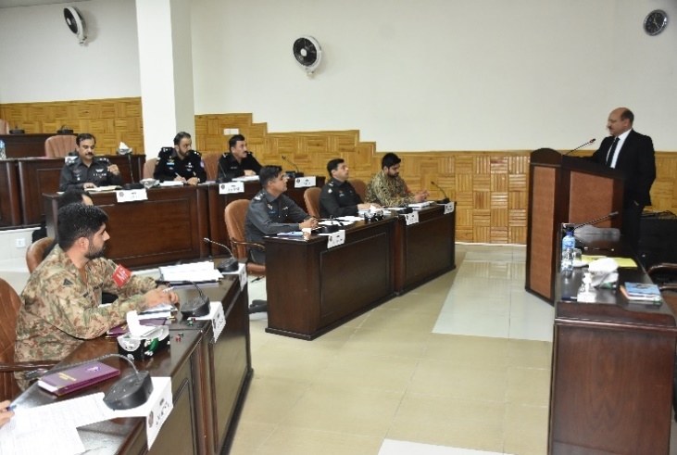
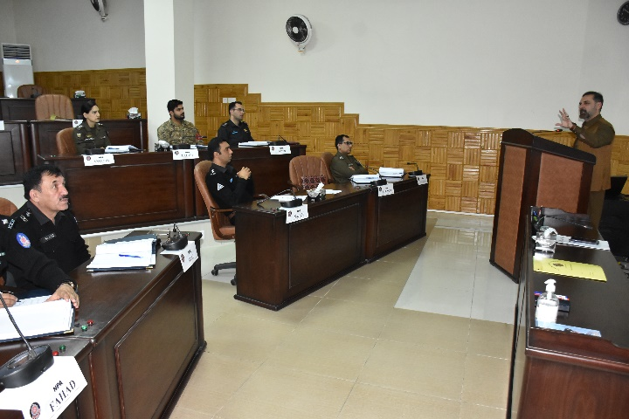
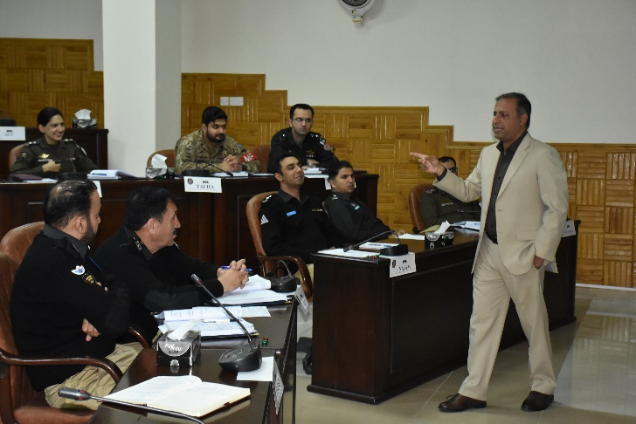
42nd MCMC Lecture Series
Addl. IGP Muhammad Ali Babakhail, PSP
ASC Shah Khawar
DIG Mirvais Niaz, PSP
Dr. Yasir Masood Afaq
7

Slide 8
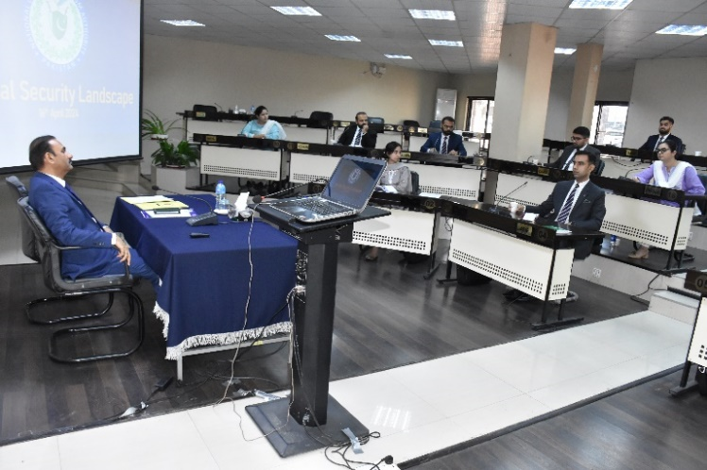
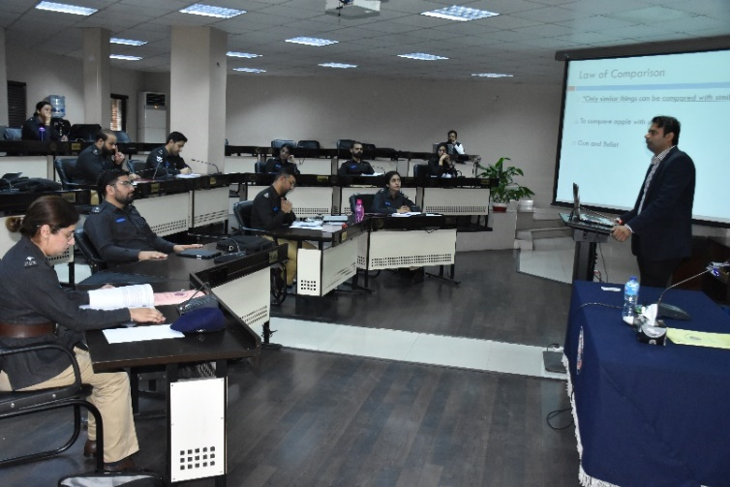
27th ICC / 51st STP
The 27th Initial Command Course (ICC) / 51st Specialized Training Programme (STP) for Assistant Superintendents of Police commenced on 14th April, 2024. The batch comprises 18 officers, including 8 female officers. The Initial Command Course, spanning 19 months, is designed for Assistant Superintendents of Police (ASsP) under training.
The group includes 10 officers from Punjab, 4 from Sindh, 2 from Khyber Pakhtunkhwa, and one each from Balochistan and Azad Jammu & Kashmir.
The training is divided into phases:
Foundation Phase: Spanning 4 weeks, this phase includes a 2-week initial district attachment.
Development Phase: Spread over 37 weeks, it covers academic training, physical activities, and the FPO Exam.
Field Attachment Phase: Currently, the batch is undergoing a 21-week long district attachment in various parts of the country.
Group Photo of ASsP (UT)
Addl. IGP Muhammad Tahir Rai, PSP
Dr. Haroon Ahmed
8

Slide 9
27th ICC Physical Activities
Physical fitness is essential for police officers to carry out duties with strength, alertness, and minimal fatigue. It ensures quick recovery after exertion while maintaining sound judgment in demanding situations. The Initial Command Course (ICC) enhances these capabilities through activities like riding, weapon handling, PT, drill, and obstacle navigation.
Riding Arena, NPA
Firing
Obstacle
PT
Parade
9

Slide 10
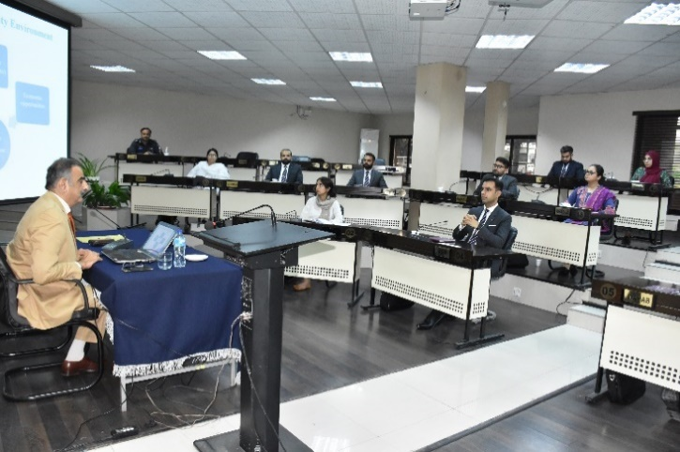
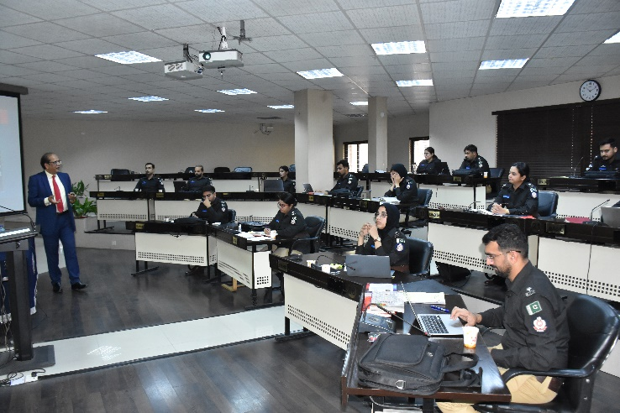
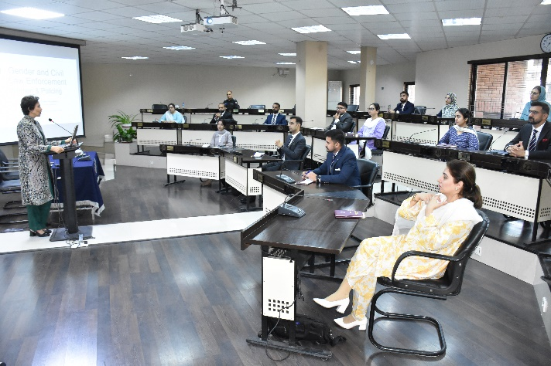
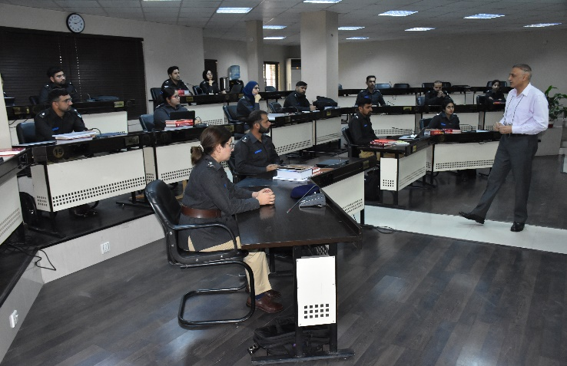
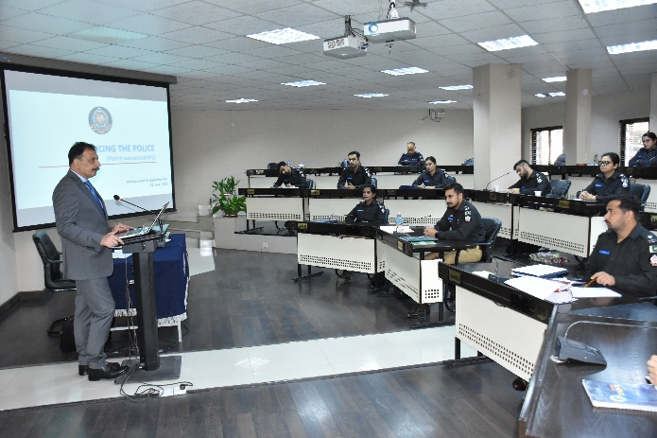
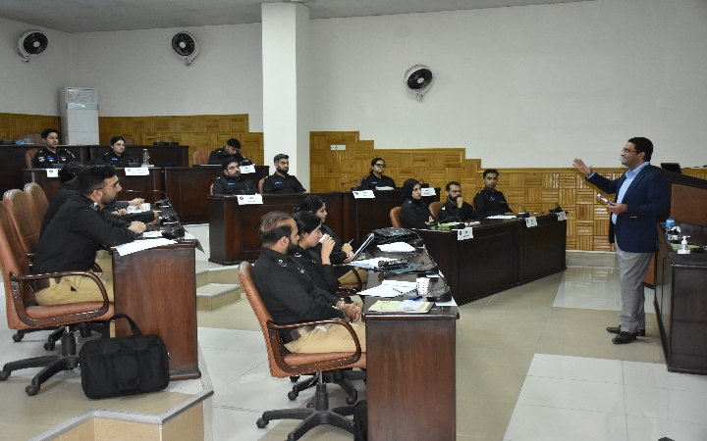
27th ICC Lecture Series
IGP (R) Shoaib Dastagir, PSP
IGP (R) Tariq Masood Yasin, PSP
Ms. Fauzia Viqar
Commandant, NPA Muhammad Idrees Ahmed, PSP
Addl. IGP Muhammad Ali Babakhail, PSP
DIG Umar Riaz, PSP
10

Slide 11
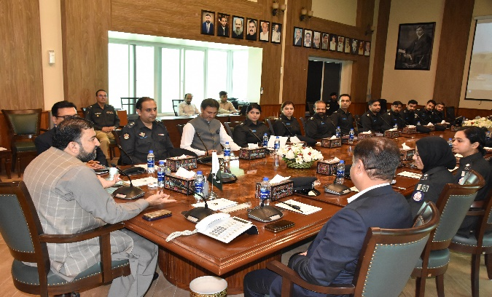
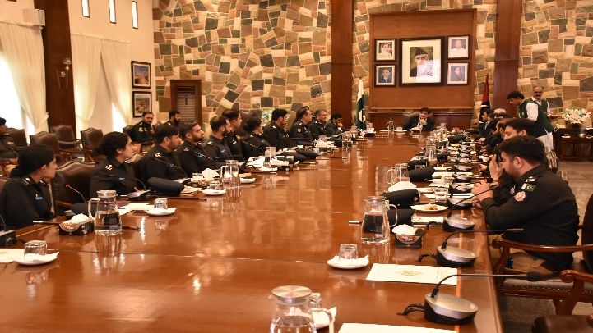
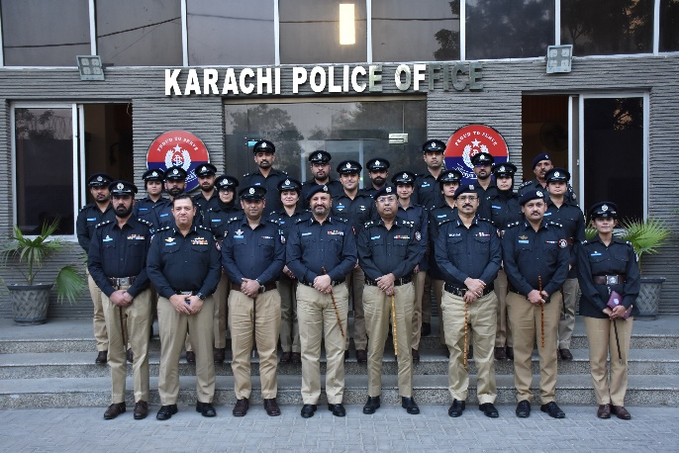
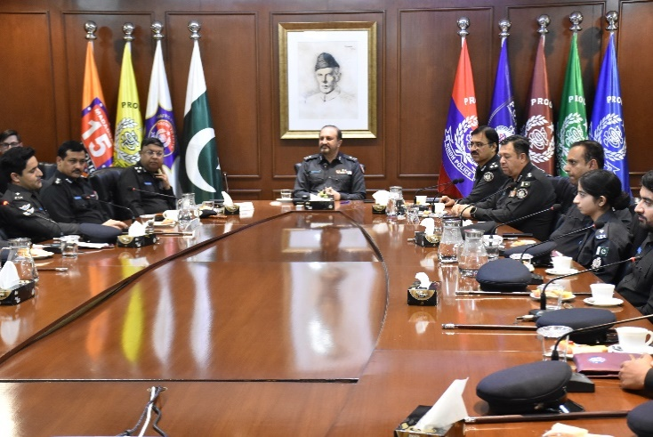
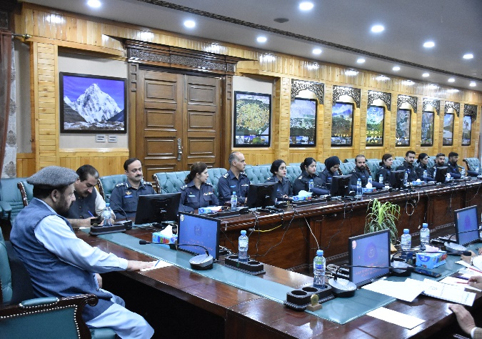
27th ICC Study Visits
As part of their training, the under-training officers of the 27th ICC undertook country study tours across all provinces of Pakistan. During these visits, they met with Chief Ministers, Governors, and Inspectors General of Police to gain insights into provincial governance and policing practices
Call on Chief Minister Balochistan at CM office Quetta
Call on Chief Minister Sindh at CM office , Karachi
Group Photo with IG Sindh
Call on Addl. IGP Karachi Police Office
Call on Chief Minister Gilgit Baltistan at CM office Gilgit
11

Slide 12
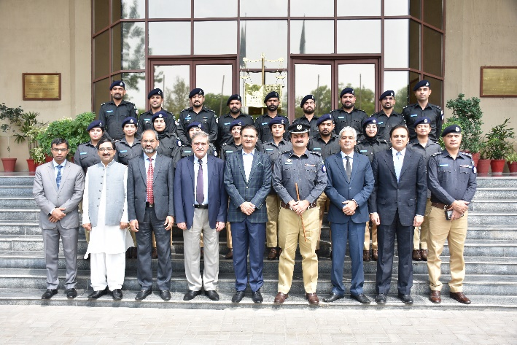
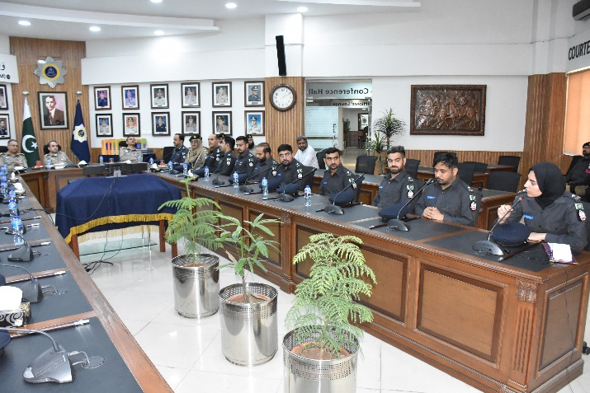
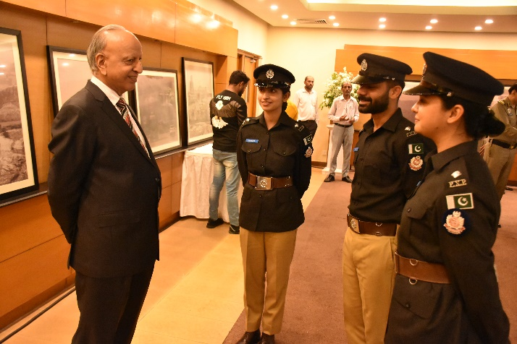
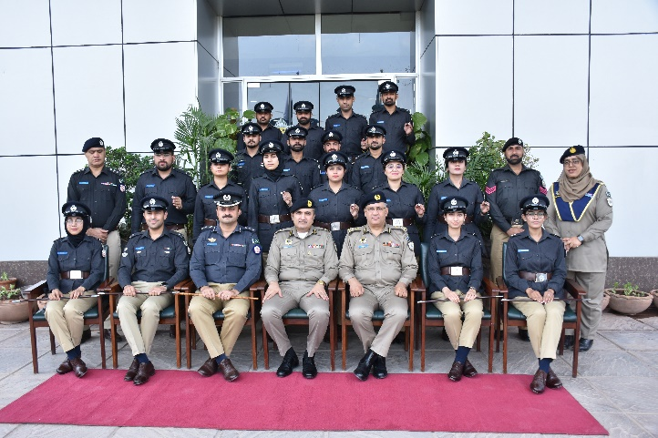
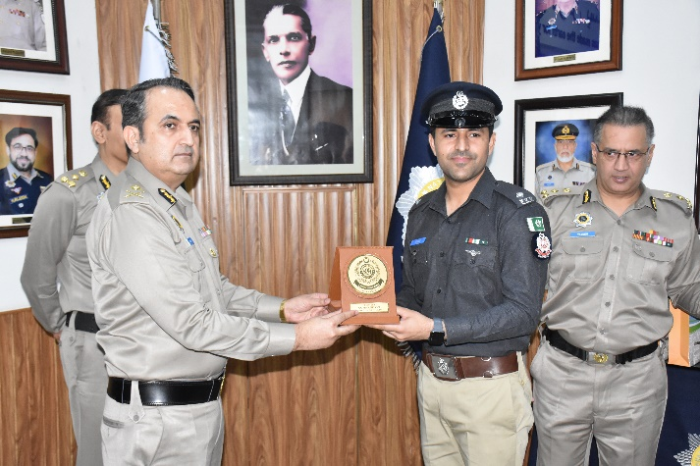
27th ICC Visit to Police Organizations
As part of their professional training, the under-training officers visited various police organizations in Islamabad. These visits aimed to enhance their understanding of policing practices, operational procedures, and institutional structures. The exposure provided valuable insights into the working of different law enforcement units and helped broaden their professional perspective.
Group Photo of ASsP UT at FJA
Visit to NHMP by ASsP UT
Visit to Islamabad Club by ASsP UT
Group Photo of ASsP UT at NHMP
ASP UT Muhammad Shoaib Amin presenting NPA Shield to Mr. Salman Choudhry, IGP, NHMP
12

Slide 13
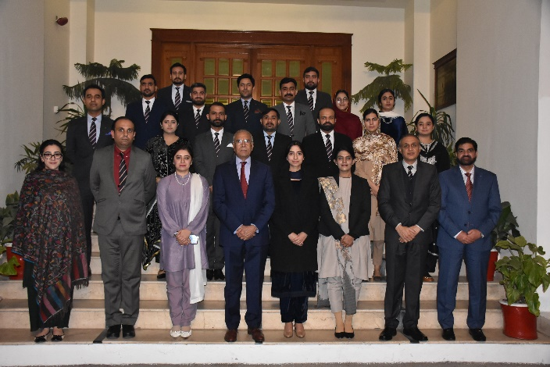
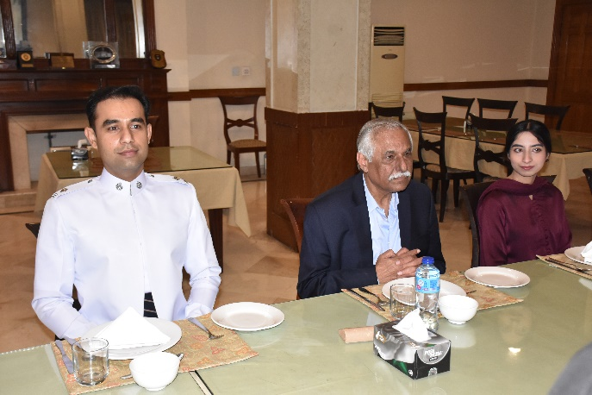
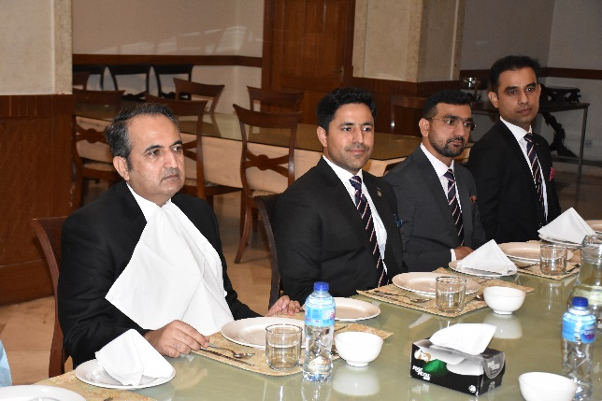
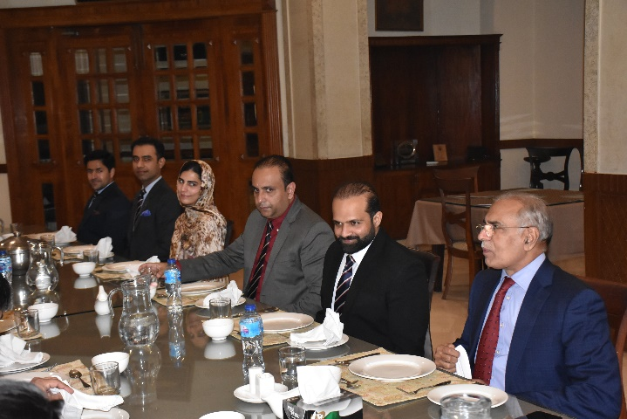
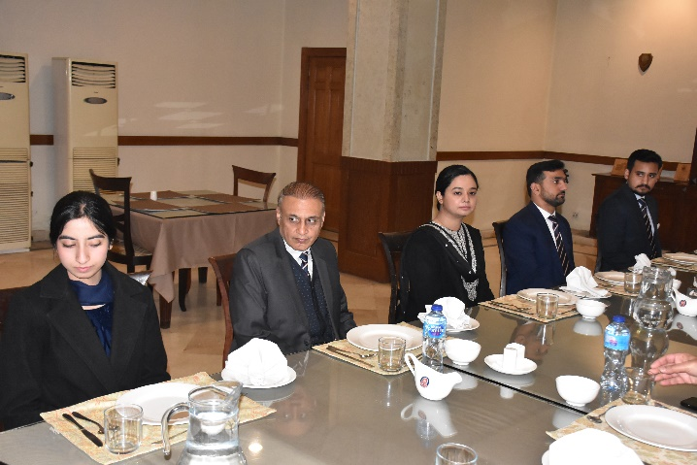
Guest Nights
Senior police officers and Assistant Superintendents of Police (UT) celebrate Guest Night event graced by the Chief Guest who share their expertise, insights and professional experiences gained during their service in various police organizations.
Group Photo with ASsP (UT)
IGP (R) Tariq Parvez with ASsP (UT)
Mr. Salman Choudhry, IGP with ASsP (UT)
IGP (R) Mushtaq Ahmad Sukhera with ASsP (UT)
Commandant, NPA Muhammad Idrees Ahmed, with ASsP (UT)
13

Slide 14
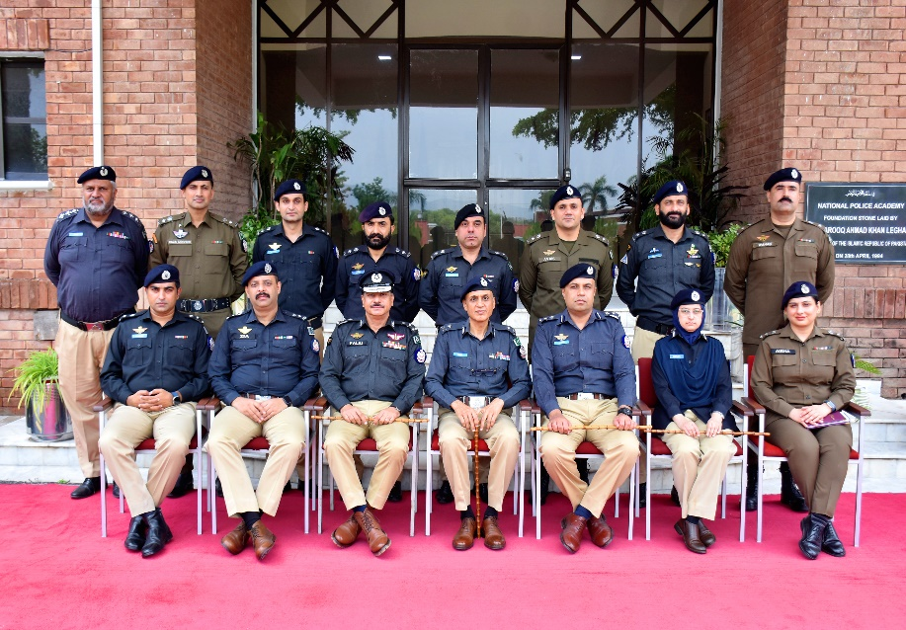
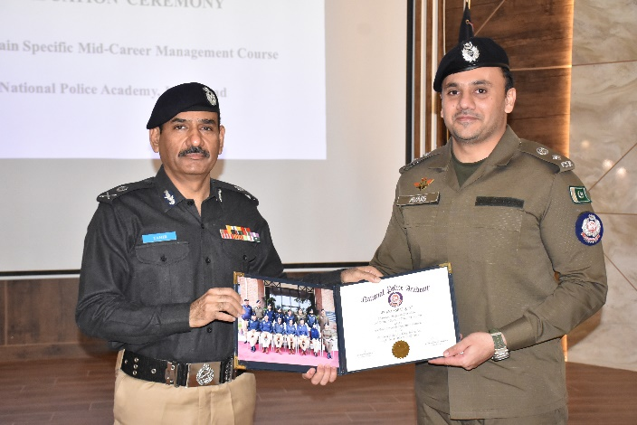
43rd MCMC Graduation Ceremony
The MCMC domain-specific course is designed for officers from Police, FIA, and NAB to enhance their professional competence and personal abilities. It focuses on organization-specific knowledge, skills, and attitudes, encouraging mutual learning and experience-sharing. The curriculum blends professional, developmental, and research components to prepare participants for future professional roles.
On 16th June, 2025, Inauguration Ceremony of 14th Domain Specific Specialized Training Course of 43rd Mid-Career Management Course (MCMC) was held at the National Police Academy, Islamabad. The batch comprises 10 officers including one female, 10 officers from PSP.
Group Photo of 43rd MCMC
Distribution of Certificates
Mr. Zia Uddin Ahmed, PSP Capt. (R) Naveed Alam, PSP
Ms. Aisha Butt, PSP Dr. Muhammad Raza, PSP
Mr. Abdul Wahab, PSP Mr. Muhammad Maroof, PSP
Mr. Hafeez Ur Rehman, PSP Mr. Avais Shafiq, PSP
Capt. (R) Dost Muhammad , PSP Mr. Touheed Rehman, PSP
Mr. Awais Shafiq, PSP of 43rd MCMC
14

Slide 15
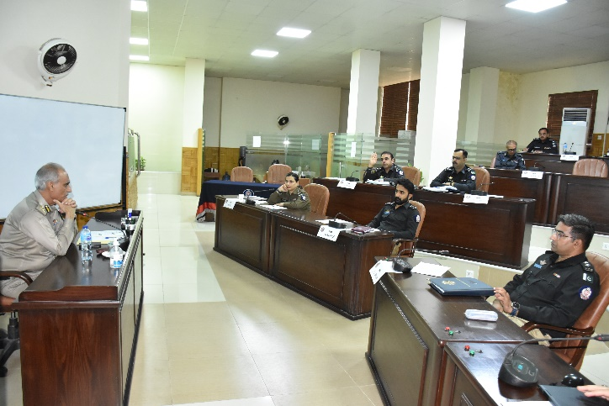
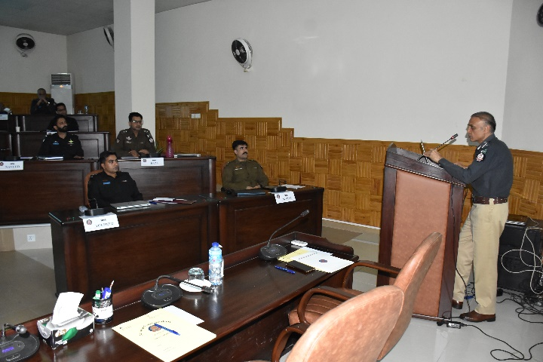
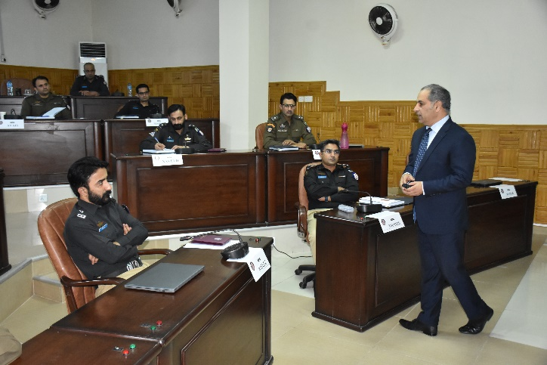
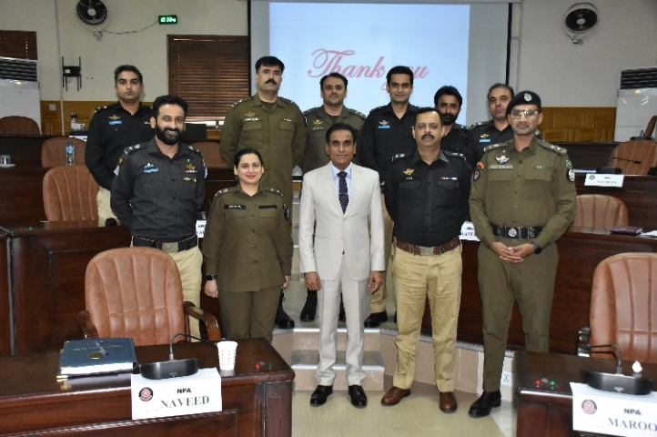
43rd MCMC Lecture Series
IGP NHMP B.A Nasir, PSP
Commandant, NPA Muhammad Idrees Ahmed, PSP
Addl. IGP Sohail Habib Tajik, PSP
IGP Abdul Khalique Sheikh, PSP
15

Slide 16





Cultural Night 43rd MCMC
The Commandant NPA, Mr. Muhammad Idrees Ahmed, PSP, IGP; Deputy Commandant, Mr. Sarfraz Ahmed Falki, PSP, DIG; Director CPTU, Mr. Haider Sultan, PSP, SSP; Director SCC, Ms. Shazia Sarwar, PSP. SSP; and the under-training officers of MCMC gathered for the Cultural Night at the NPA. It was an evening of unity and celebration, showing the richness of Pakistan’s diverse cultures and promoting mutual understanding and respect.
16

Slide 17




2nd Specialized Training Course for DSsP (UT) Sindh
The 2nd Specialized Training Course for Deputy Superintendents of Police (DSsP)/UT commenced on 24th Feb, 2025. The batch comprises 45 officers, including 10 female officers. The Specialized training Course, spanning 15 months, is designed for Deputy Superintendents of Police (DSsP)/UT under training.
Structured in four progressive phases: Foundation, Development, Attachment, and Consolidation, the program aims to build leadership, discipline, and operational readiness among the officers.
The batch is currently undergoing the Development Phase, which includes 24 weeks of intensive classroom sessions, physical activities, final exam and country study tours.
Group photo of 2nd STC, DSsP
Commandant, NPA Muhammad Idrees Ahmed, PSP
IGP (R) Tahir Alam Khan, PSP
Dr. Zubaida Zain
17

Slide 18





2nd STC DSsP, Physical Activities
Physical activities and skill development such as riding, weapon handling, physical training (PT), drill, and obstacle courses are essential for enhancing the physical fitness of police officers. These activities help officers to perform critical tasks with vigour, alertness, and minimal fatigue, while ensuring a rapid recovery after intense exertion. It is vital that, during and after periods of physical exertion, a police officer is able to maintain sound judgment and make effective decisions.
Obstacle
Parade
PT
Firing / Swimming pic
18

Slide 19





Guest Nights of 2nd STC DSsP, Sindh
Guest Night is a formal event organized for the Deputy Superintendents of Police (DSsP) undergoing training at the National Police Academy. The occasion is graced by the Commandant, senior officers from within the Academy, and distinguished guests. It provides an excellent opportunity for the probationary officers to engage with senior police leadership and build professional camaraderie.
Group Photo with DSsP (UT)
Addl. IGP Muzaffar Ali Shaikh, PSP
with DSsP (UT)
DSP (UT) Mr. Sadam Hussain Presenting NPA Shield to IGP (R) A.D Khawaja, PSP
Group Photo with DSsP (UT)
IGP (R) A.D Khawaja, PSP
with DSsP (UT)
19

Slide 20



Workshops
Jan 2025 to June 2025
Course | Organization | Dates
Driver Improvement and Safety Course | NPA | 5-8 May
Other Situation Violence (OSV), Armed Conflict and International Law for Practitioner | ICRC | 20-22 May
The Use of Technology Tools in Investigation for Officers | NPA | 2-4 June
The National Police Academy continues to play a vital role in strengthening the capacity of senior law enforcement personnel. As part of its ongoing training program, the Academy organizes workshops for officers from a wide array of organizations, including the Police, Military Intelligence, ISI, NAB, FIA, PAF, Rangers, IB, FC, Frontier Corps, NPB, NACTA, State Bank, FBR, ASF, CAA, and Prisons. These sessions focus on enhancing inter-agency collaboration, professional skills, and leadership capabilities.
The academy trained 45 officers in January 2025– June 2025 through workshops programs. Every year officers from around 30 Law Enforcement Agencies and other organizations of Pakistan are invited to attend Workshops at NPA.
20

Slide 21
NATIONAL POLICE ACADEMY
National Police Academy
Commandant
Mr Muhammad Idrees Ahmed, IGP
Deputy Commandant
Mr Sarfraz Ahmed Falki, DIG
DIG/ Director
Central Planning & Training Unit
Mr. Haider Sultan, SSP
Course Commander
Mr. Fazl-i-Hamid, SSP
Director
Senior Command Course Ms. Shazia Sarwar, SSP
Deputy Director Administration
Mr. Muhammad Farooq
NEWSLETTER
JAN-2025-JUNE-2025
VOL 07 ISSUE 01
Vision
To be a leading police training institute and a role model for all training institutes at national level imparting high quality training to in-service as well as newly recruited mid-level police managers. To uphold standards of performance, best practices reflecting values of a good public service organization and to be a center of excellence for all police training institutions.
Mission
Endowing police officers with ideals of justice, integrity and professional excellence through transformative training.
Content, design & composition
Mr. Fazl-i-Hamid, PSP, SSP
Course Commander
Syed Mazhar Hussain Kazmi, DSP
Assistant Director/CD
THE BOARD OF GOVERNORS OF THE NATIONAL POLICE ACADEMY, ISLAMABAD
National Police Academy Islamabad is administered by an autonomous board appointed by the government through ministry of interior and narcotics control and was duly registered under the Societies Registration Act, XXI of 1860 on 19th February 1979
NATIONAL POLICE ACADEMY, ISLAMABAD
SECTOR H-11, A K BROHI ROAD
www.npa.gov.pk
Telephone 00 92 (0) 51 9257419-21
Facsimile 00 92 (0) 51 9257414
22

